Slide 1
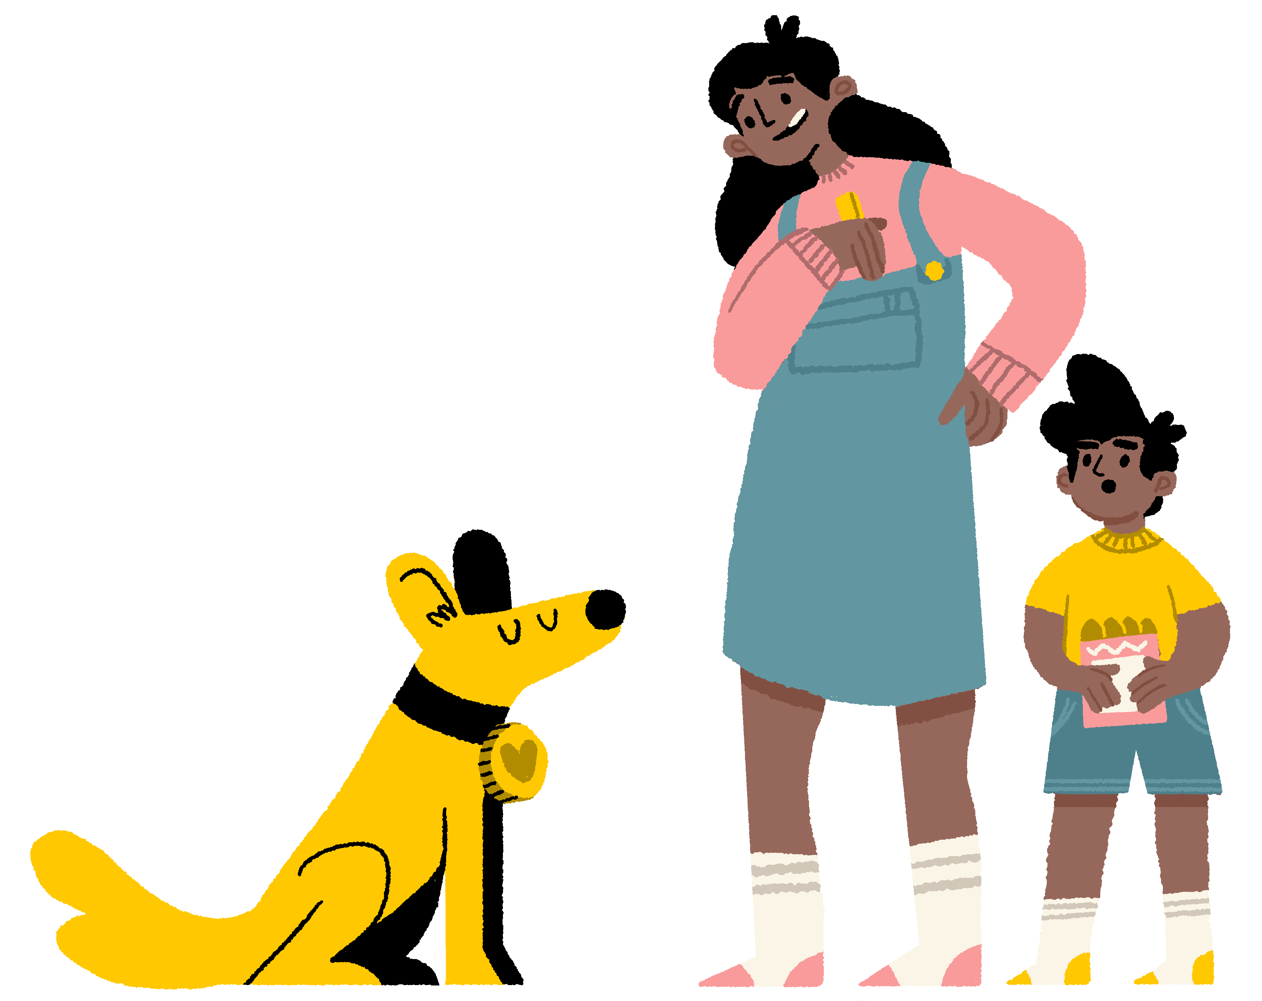
Caring for
my dog
Do you know what it takes to be a responsible dog owner?
learnwithdogstrust.org.uk
Dogs Trust Registered Charity Numbers: 1167663 and SC053144 & Company No. 09365971
A dog is for life®

Slide 2
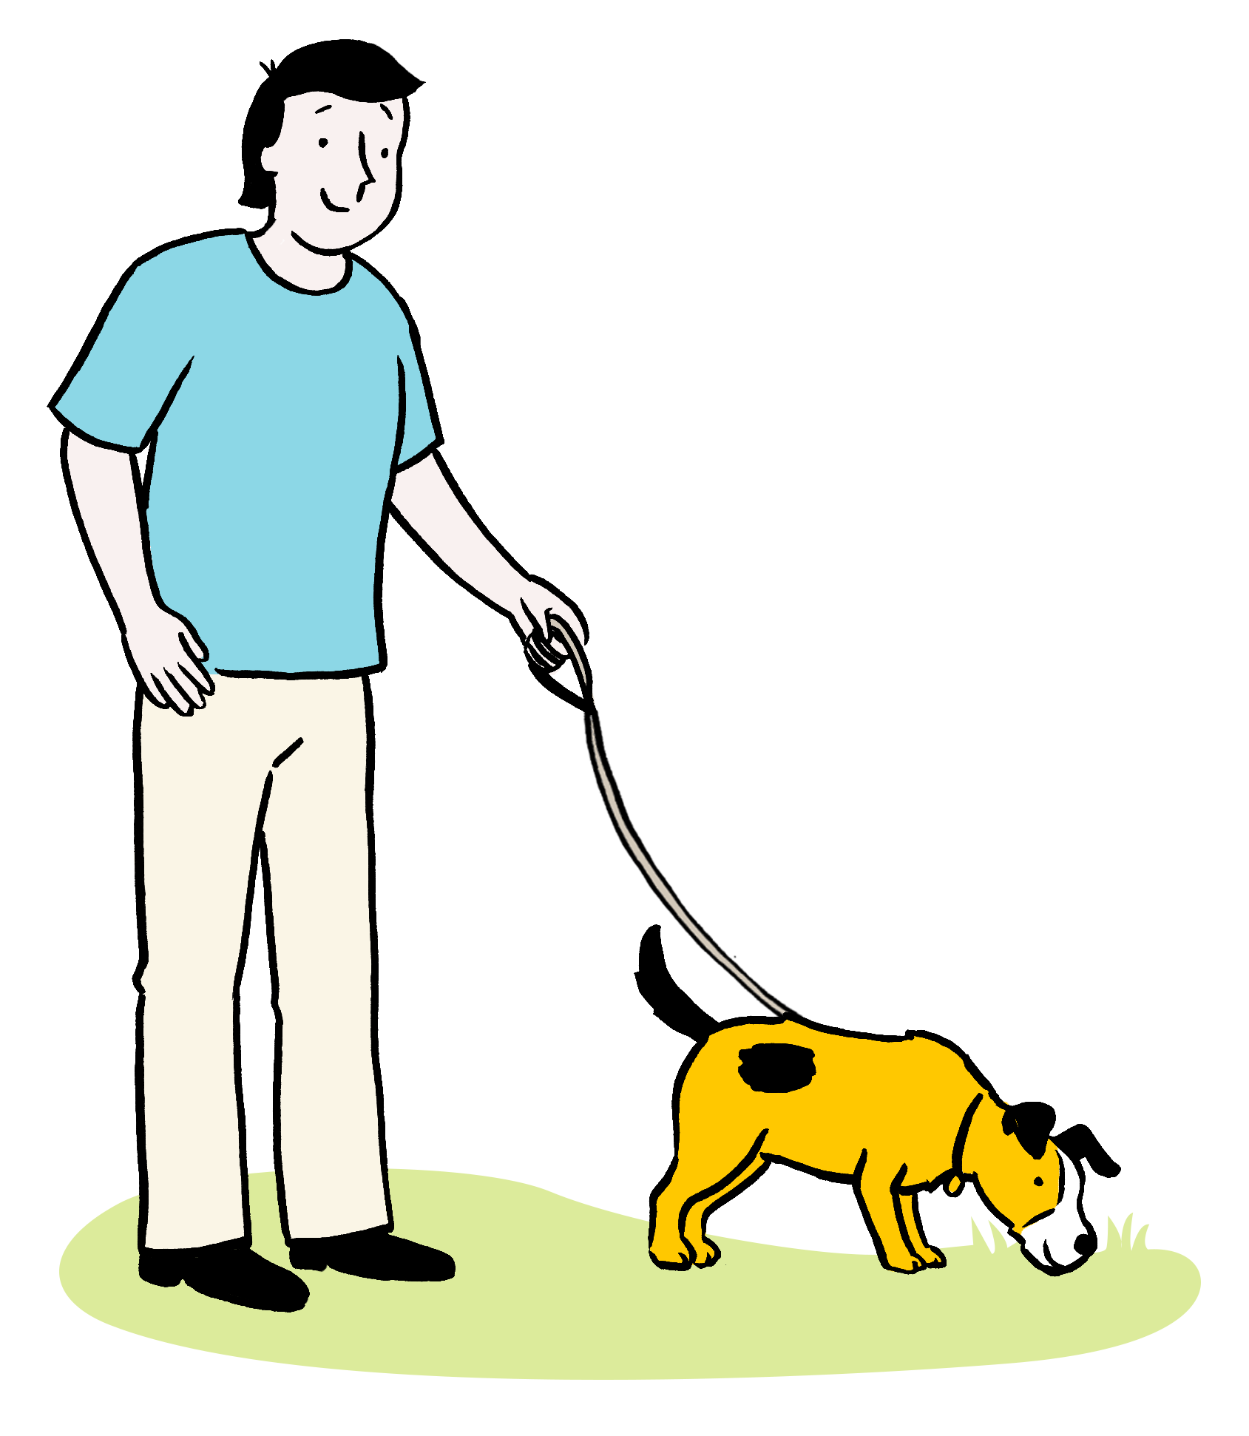
How often should a dog be taken on a walk?

Slide 3
Everyday
Regular exercise is important so that dogs stay fit and healthy. All dogs benefit from the chance to explore, sniff, and socialise when out on a walk.
The amount and type of exercise needed is different for every dog as every dog is an individual, just as humans are.

Slide 4
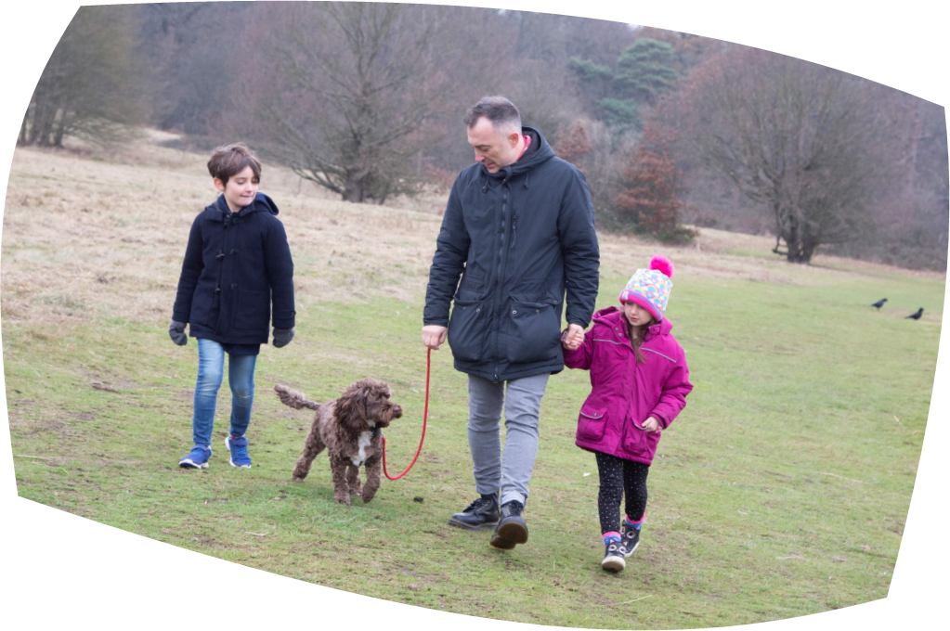

Slide 5

It is the law that every dog has an _____ attached to their collar or harness.

Slide 6
ID tag
Any dog in a public place must have the name and address of their owner (and we suggest phone number too) on an ID tag attached to their collar.

Slide 7
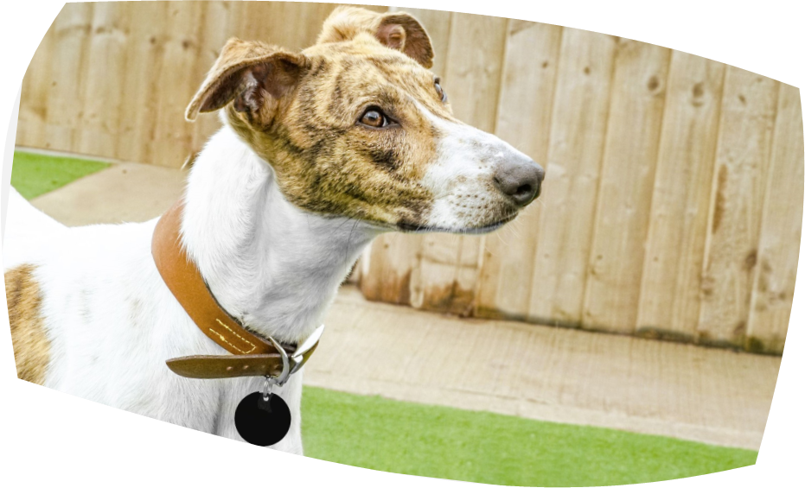


Slide 8
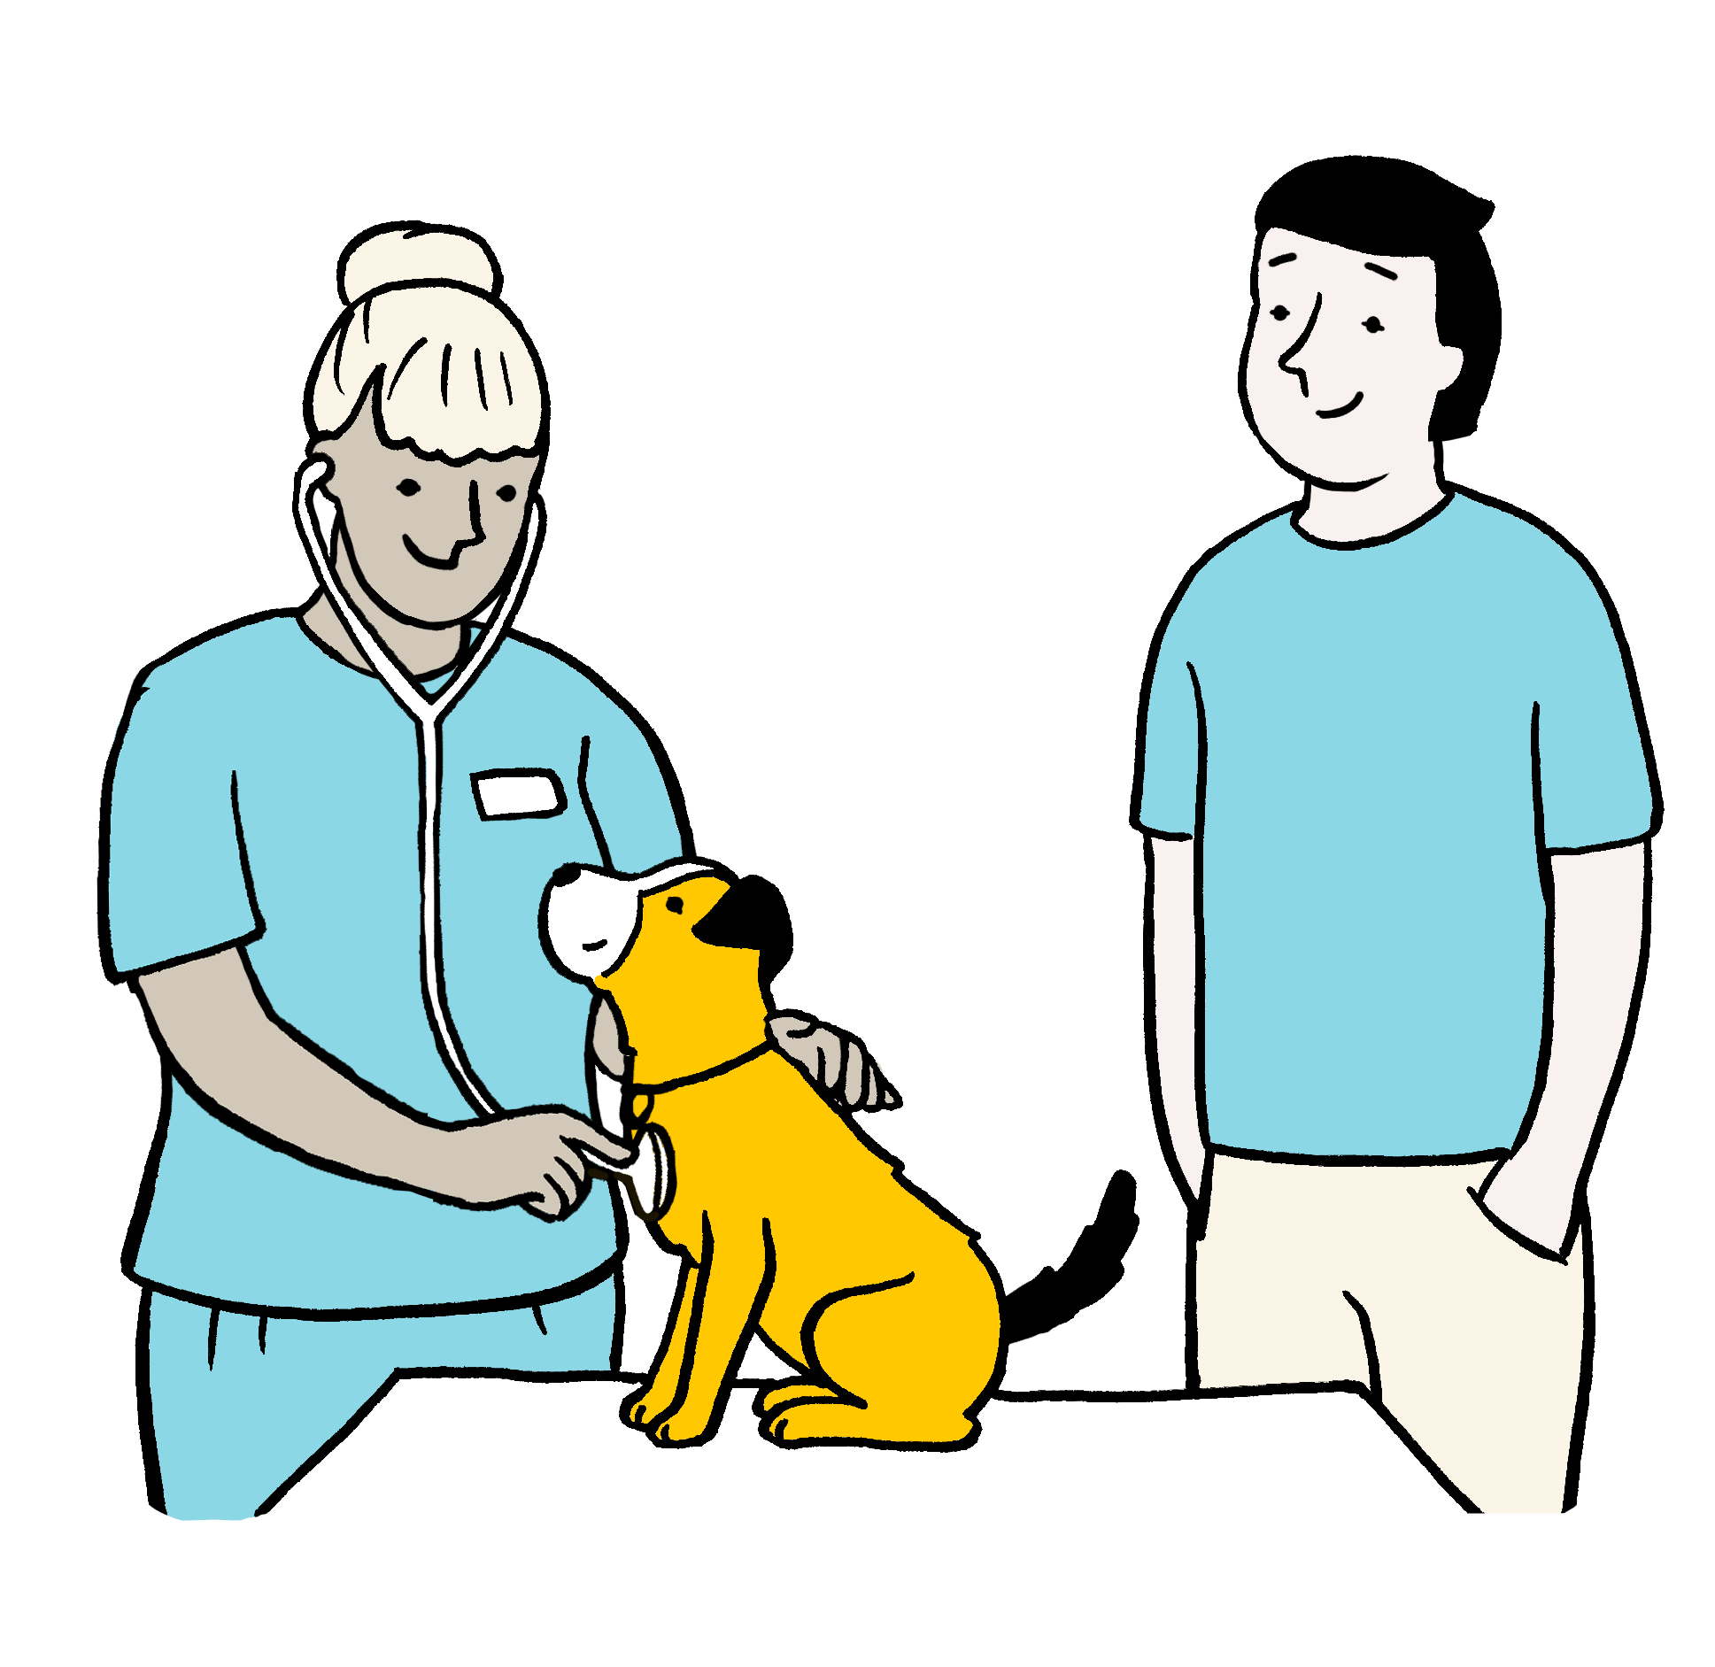
The number of times per year a dog should visit the vet for their vaccination booster and a general check-up.

Slide 9
One
Vaccinating your dog stops them from catching and spreading deadly diseases to other dogs, meaning the whole of the dog population is a little safer!

Slide 10
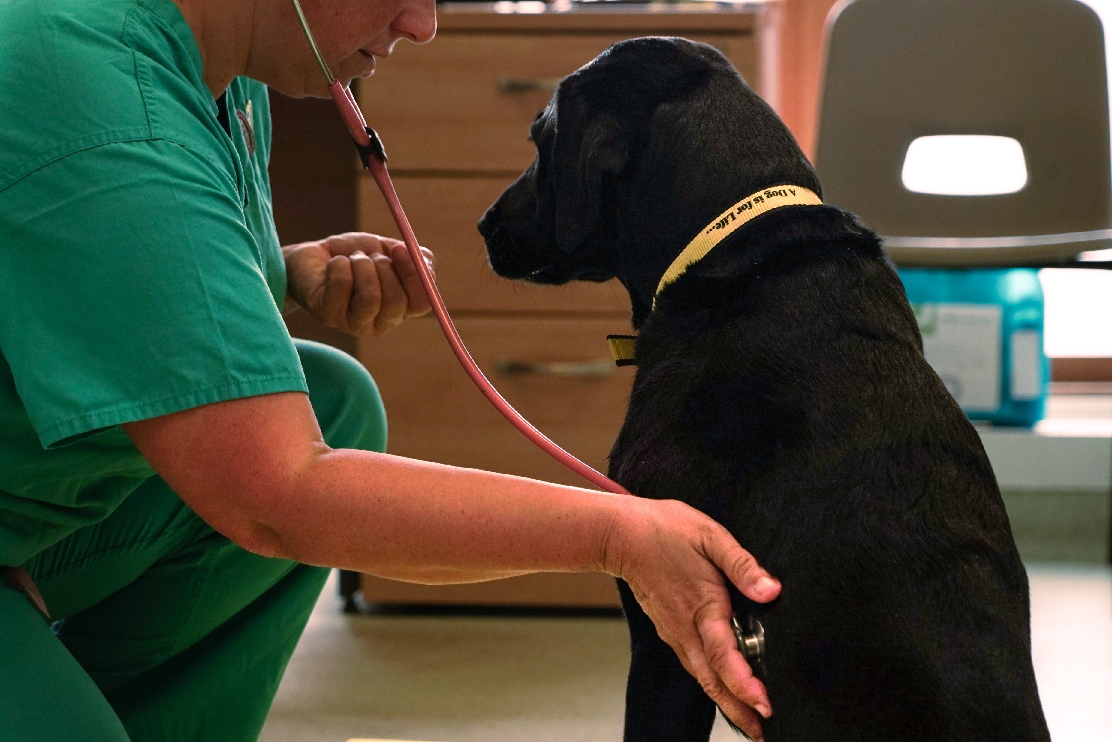

Slide 11
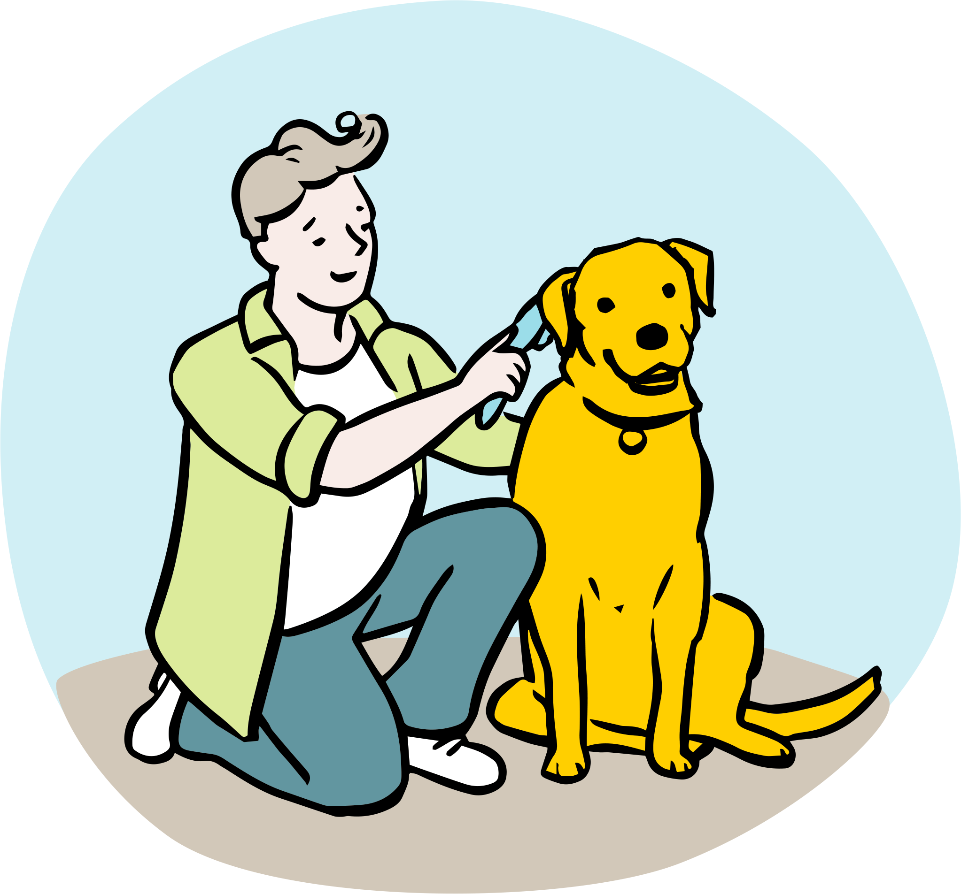
Dogs need to be _______ 3 to 4 times per week. It is important to prevent their fur from matting or becoming knotted and tangled.

Slide 12
Groomed
It not only prevents knots and matting, but it gets rid of loose fur and dirt / things that may have got stuck in their coat.
It’s important to be gentle when grooming dogs and to give them time to get used to it.

Slide 13
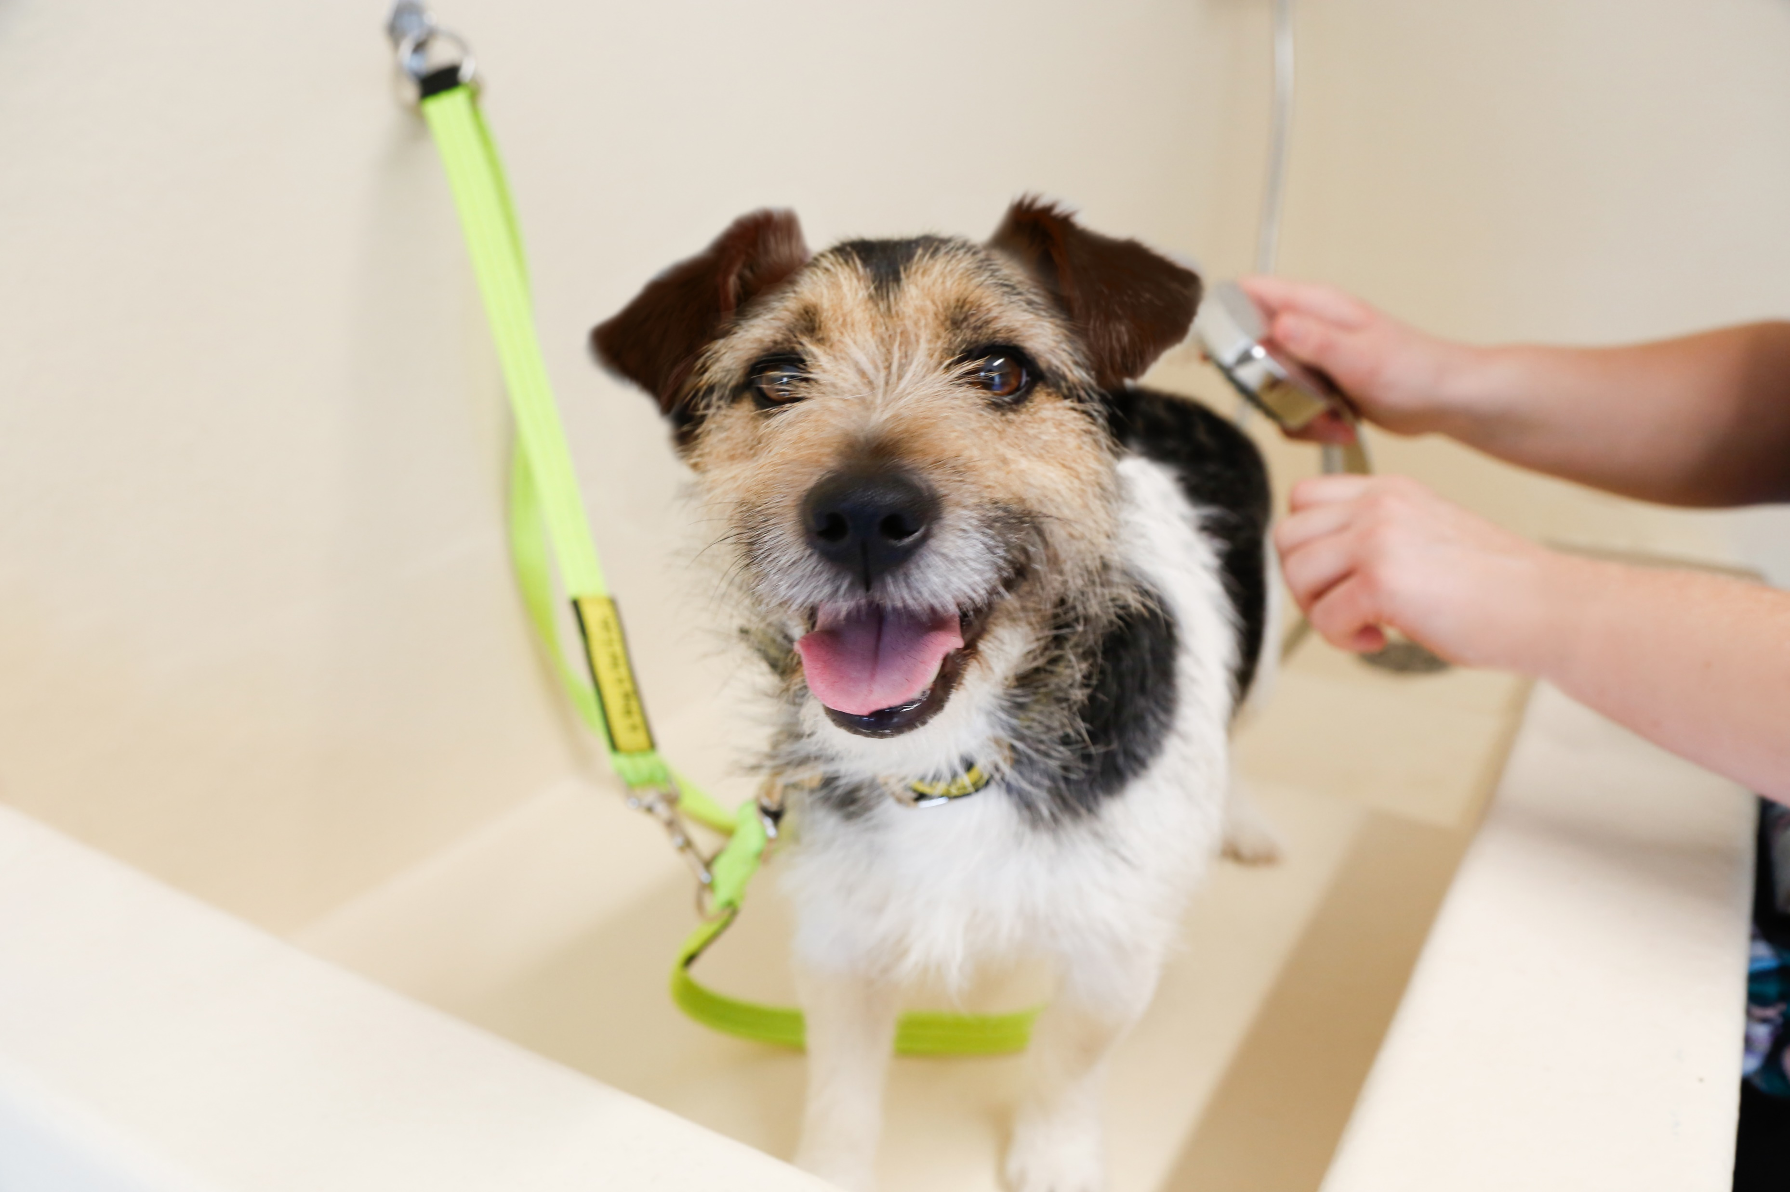

Slide 14
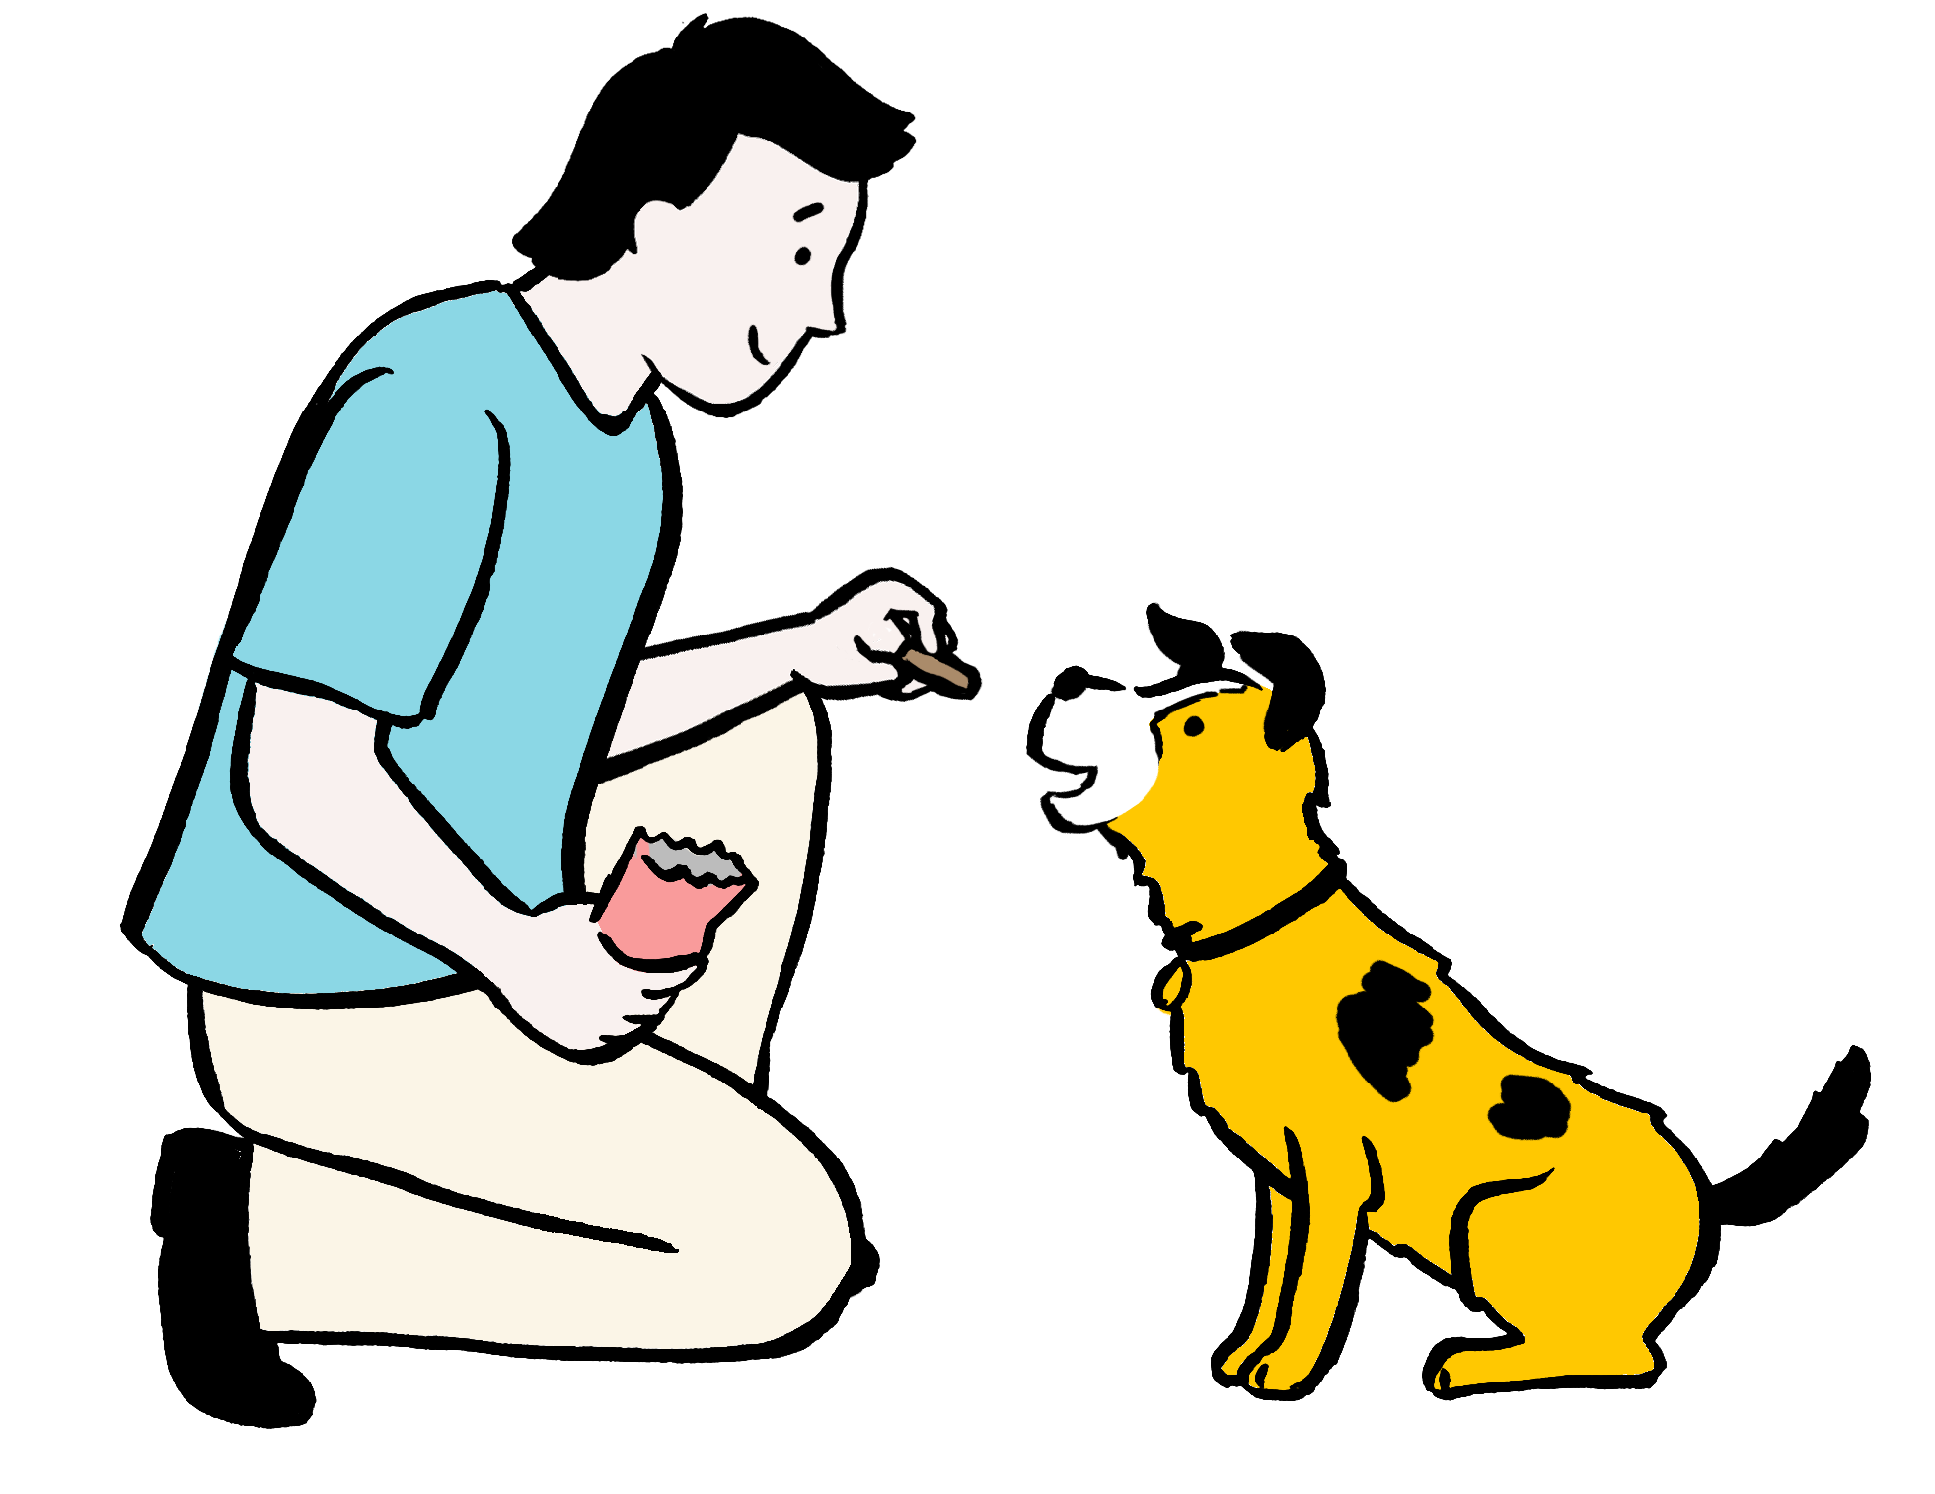
Dogs need to be ________ using treats and praise so they know how we would like them to behave.

Slide 15
Trained
Without our help and guidance, dogs won’t know how we would like them to behave.
Ideally, dogs need to learn to sit when asked, walk calmly on a loose lead, come back when called, and to calmly settle at certain times.
Dogs should only be taught using reward-based training - this means they are taught using treats, praise, and other rewards.

Slide 16
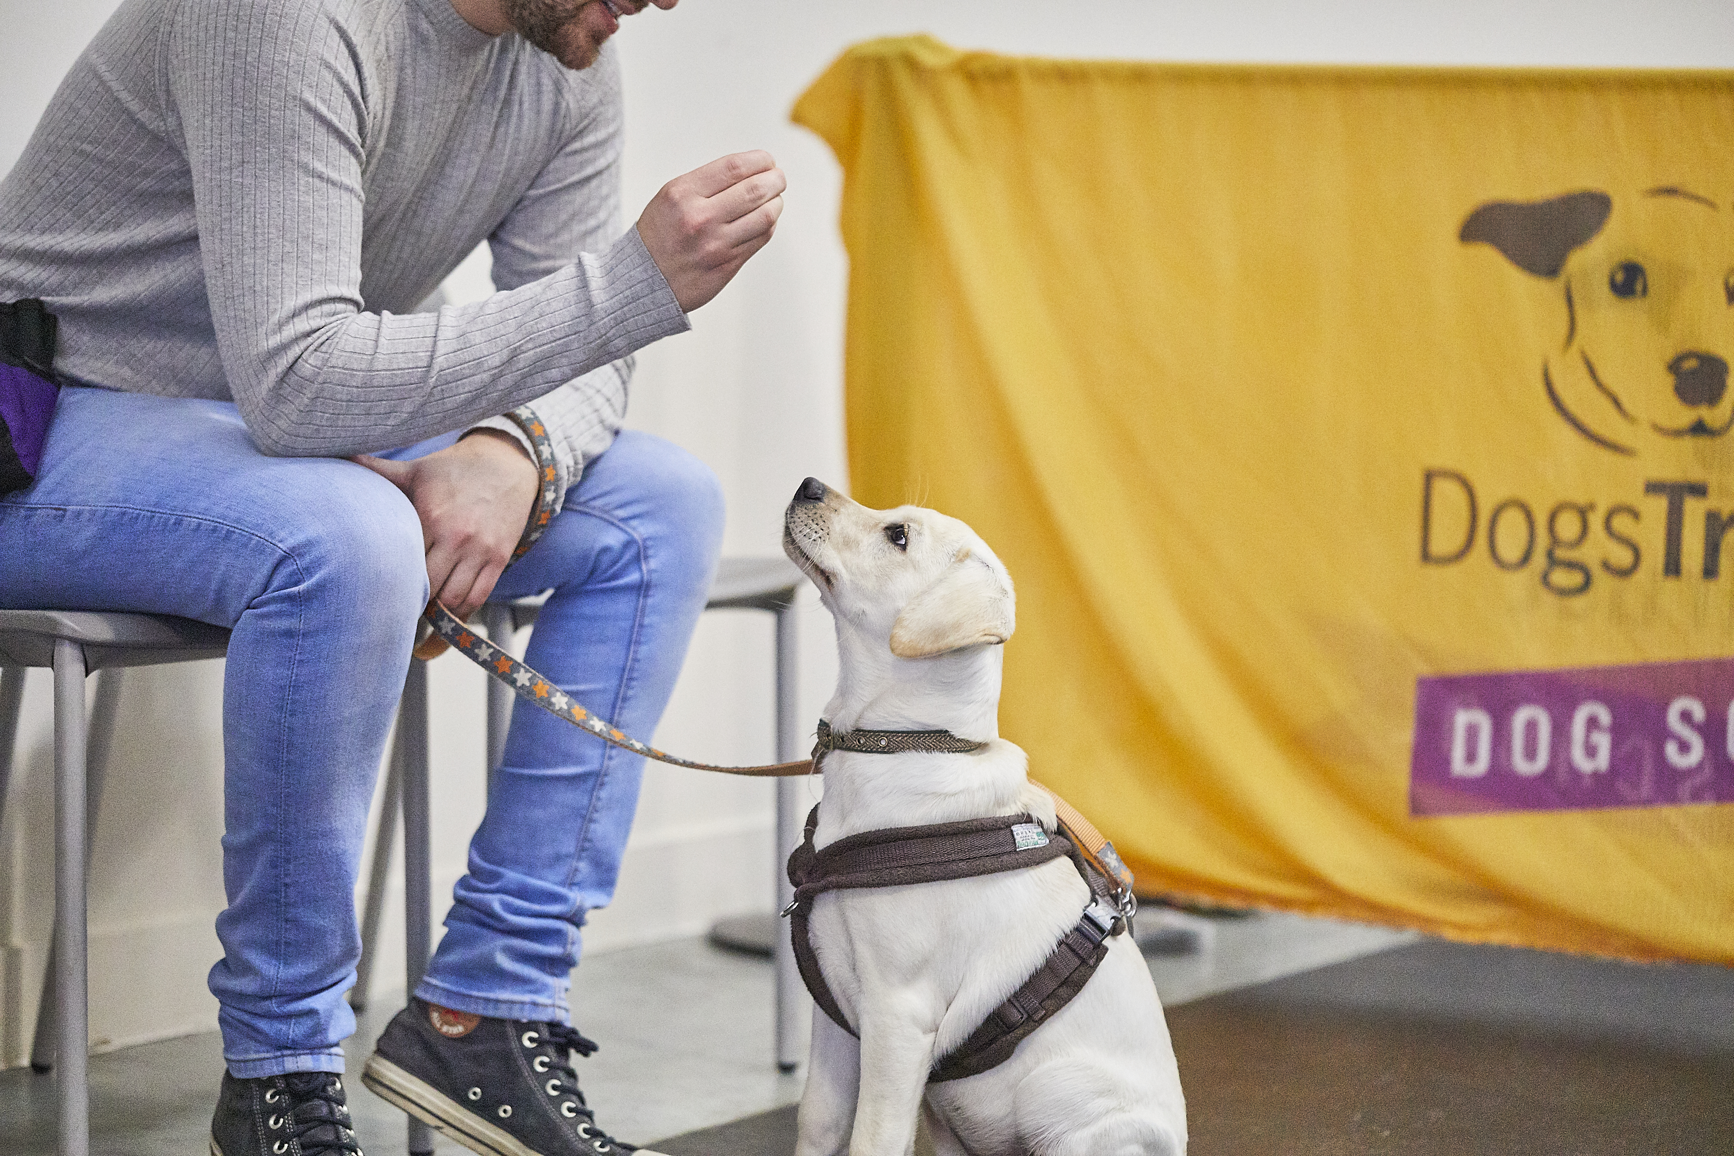

Slide 17
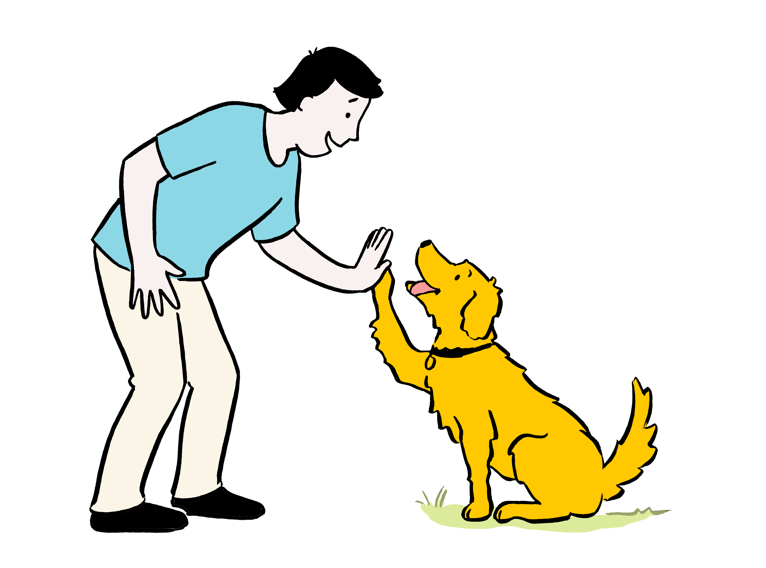
All dogs need lots of ____ and _________.

Slide 18
Love and affection
Dogs have feelings just like us. They enjoy our company and enjoy feeling loved. It is very important to remember, however, that dogs​ like to receive love and affection in different ways to humans.​ Gentle strokes are often a safe and kind way to show love and affection to a dog.

Slide 19
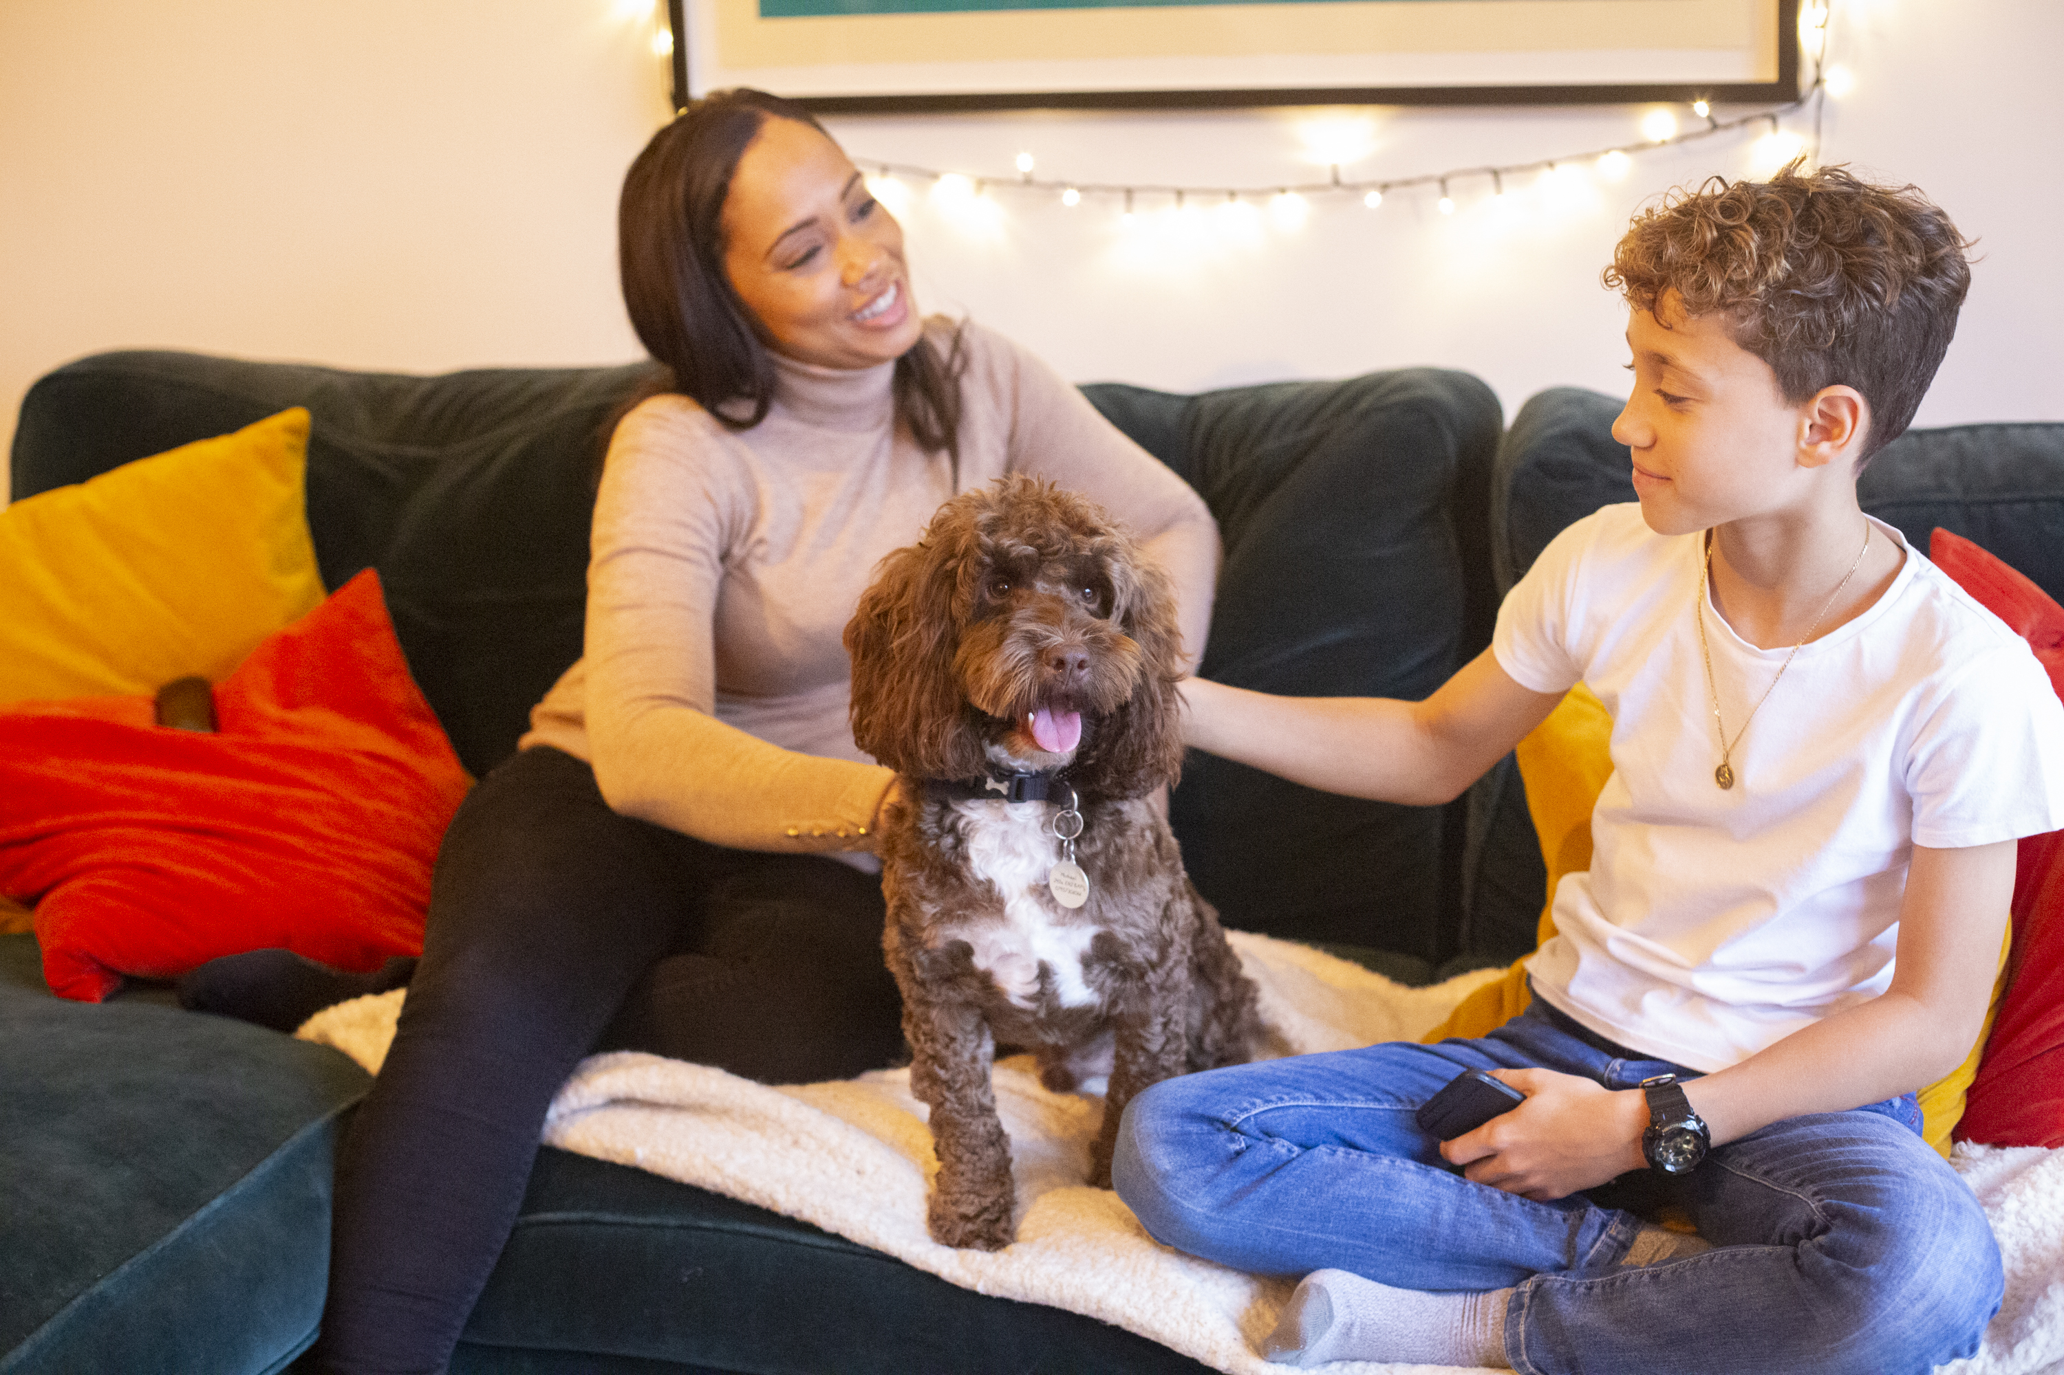

Slide 20
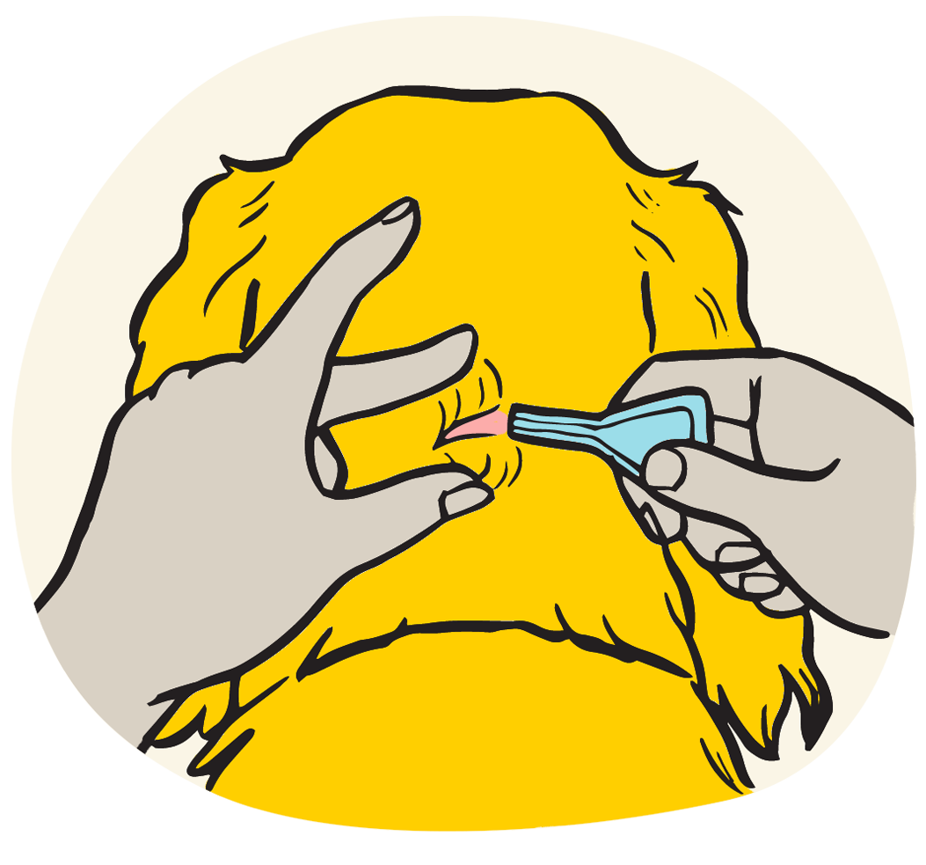
How often a dog needs to be ​treated for fleas and worms.​

Slide 21
Every 1-3 months
Treatments can come in different forms, but should​ be given every 1 to 3 months to prevent dogs from​ catching and spreading these parasites.​

Slide 22
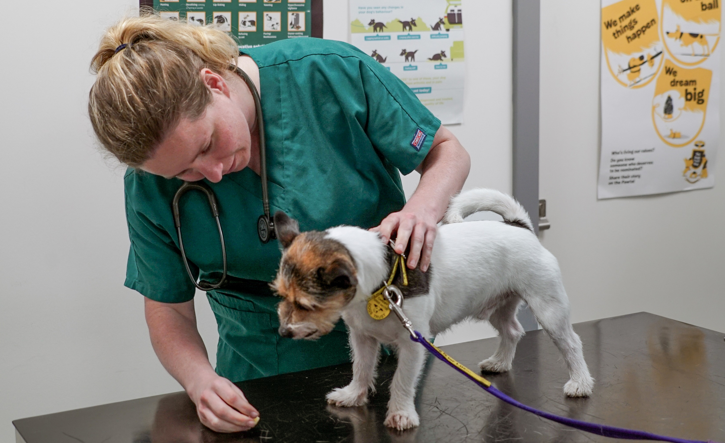

Slide 23
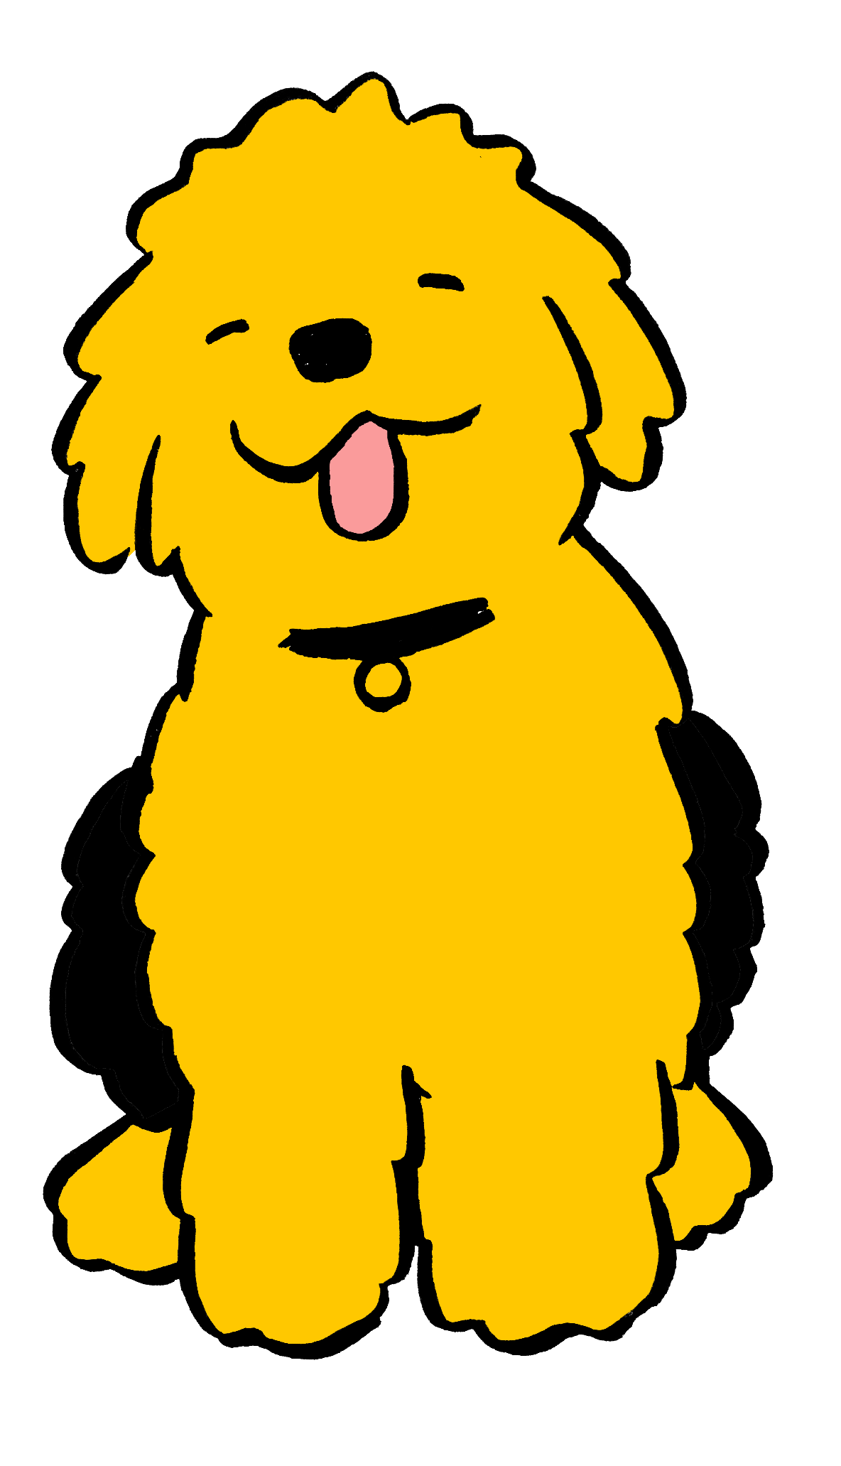
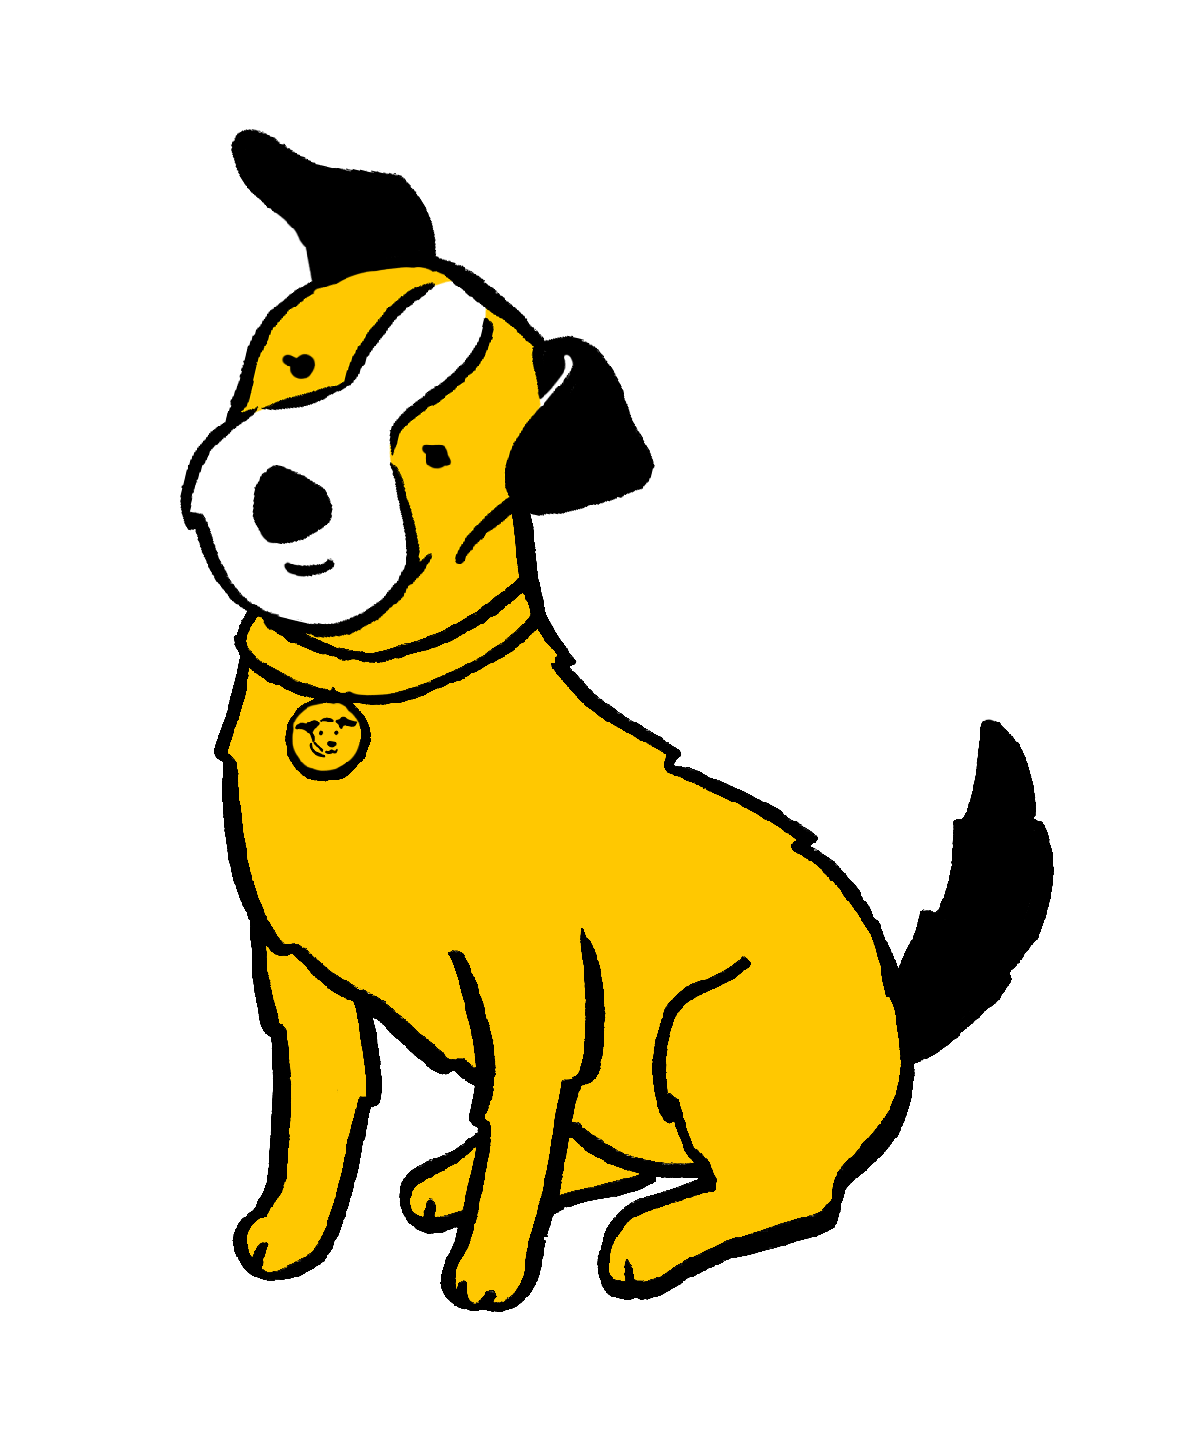
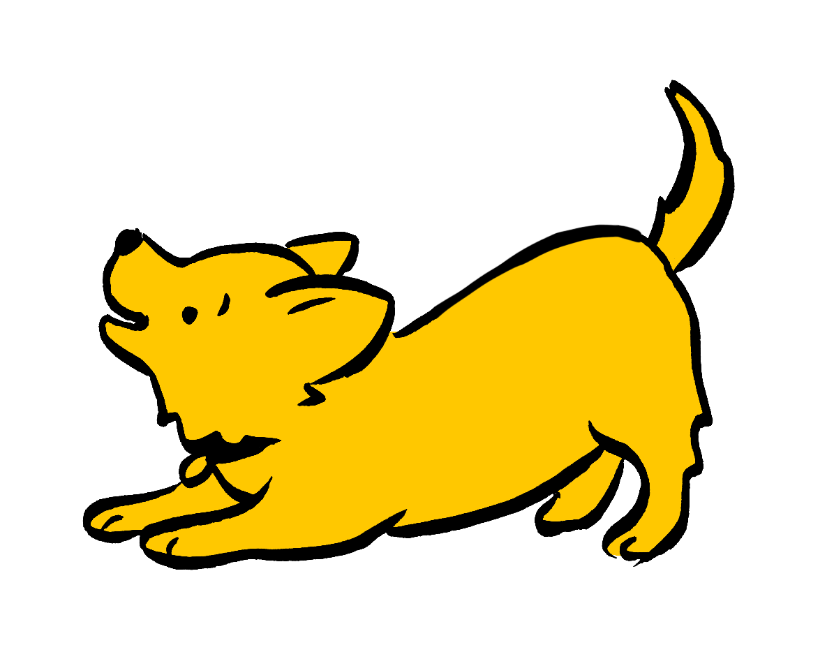
It is important ​to consider the _____ ​of dog before getting one. ​

Slide 24
Breed
You should always research the type or breed of dog you’re interested in before considering whether to buy or adopt.
This is because each breed has different characteristics and needs in terms of exercise, food, training, and enrichment. Some breeds are also more likely to have health issues, which can affect pet insurance costs and more.​

Slide 25
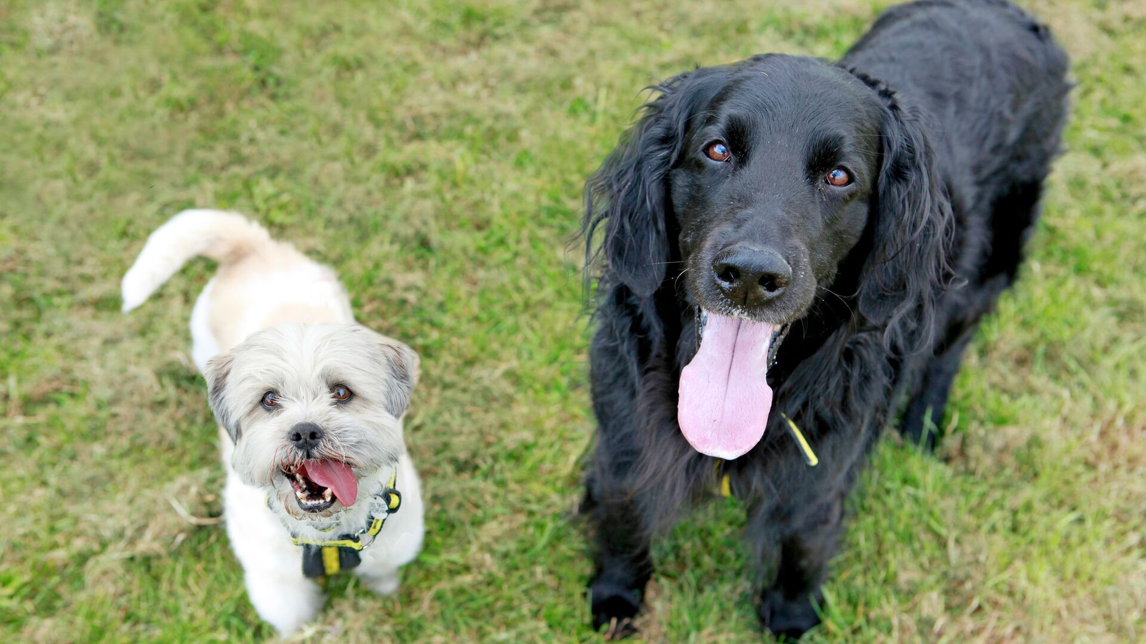

Slide 26
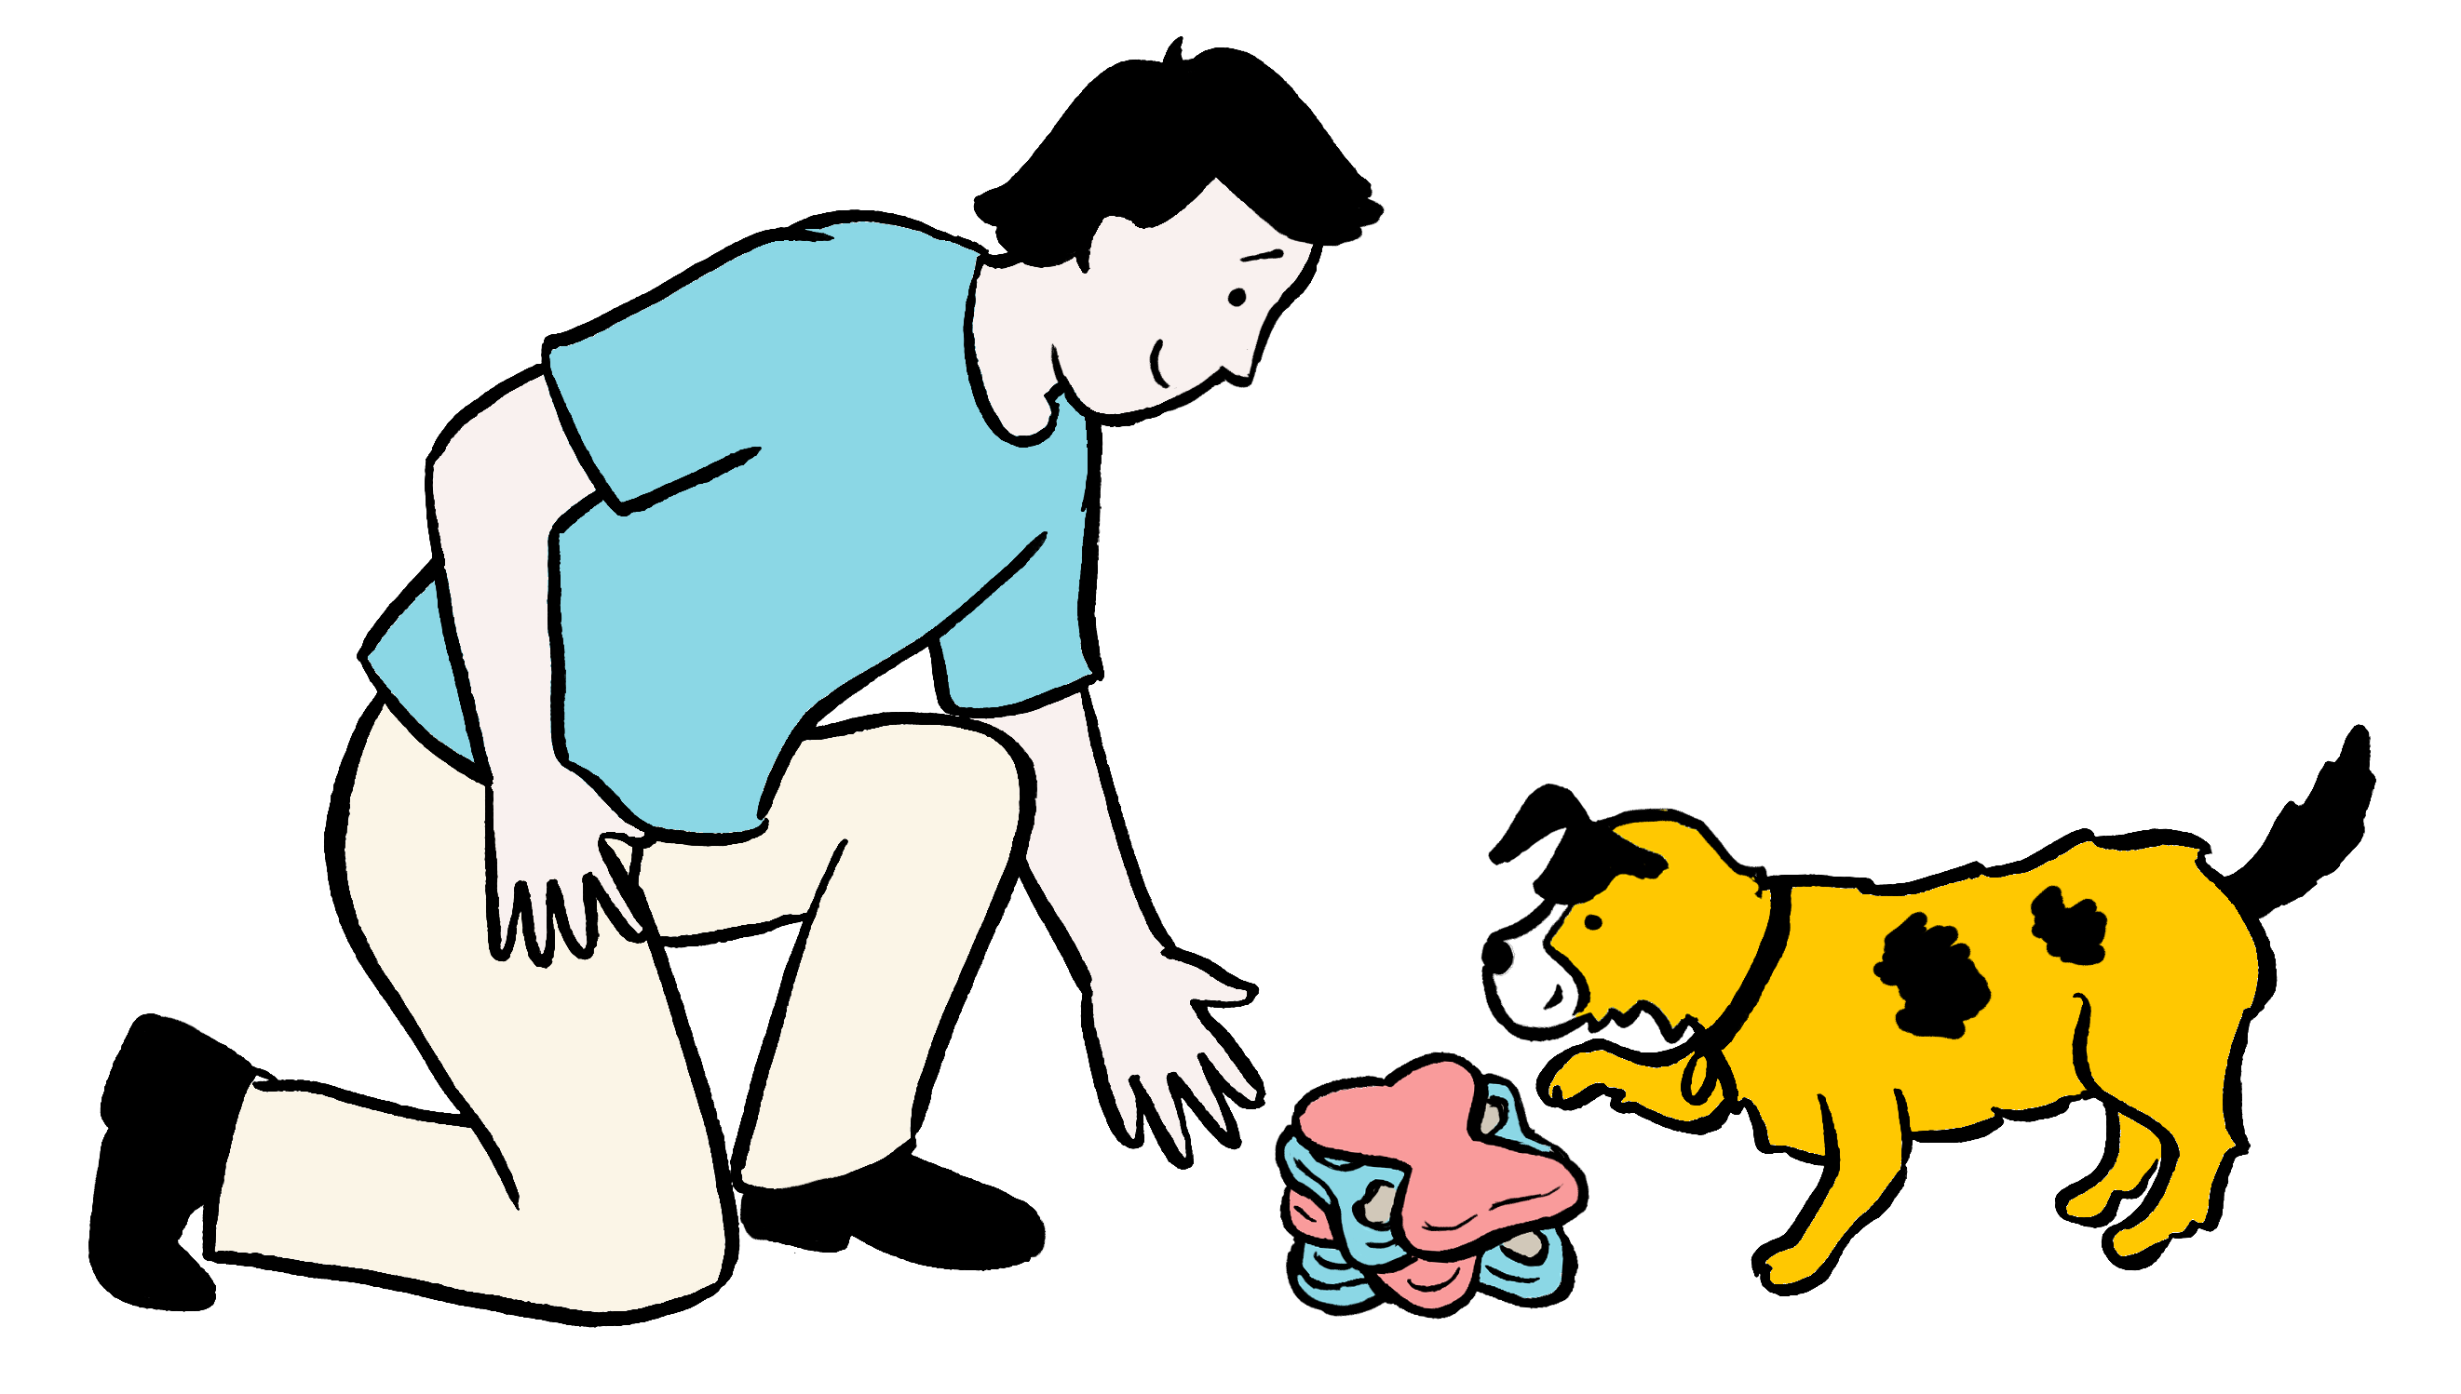
All dogs need a​ selection of ______ to play with so that​ they don’t become bored or frustrated.​ ​

Slide 27
Toys
Dogs are very clever animals and it is important to provide them with toys so that they have the opportunity to exercise their minds as well as their bodies.
It’s important to understand that it is normal for dogs to rip or destroy toys as often that is what they think the toys are for, and that is how they enjoy playing with them.

Slide 28
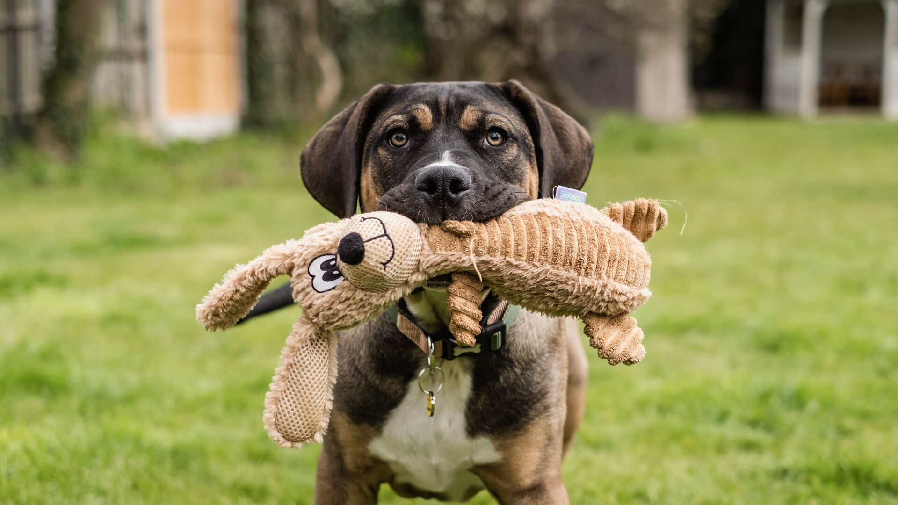

Slide 29
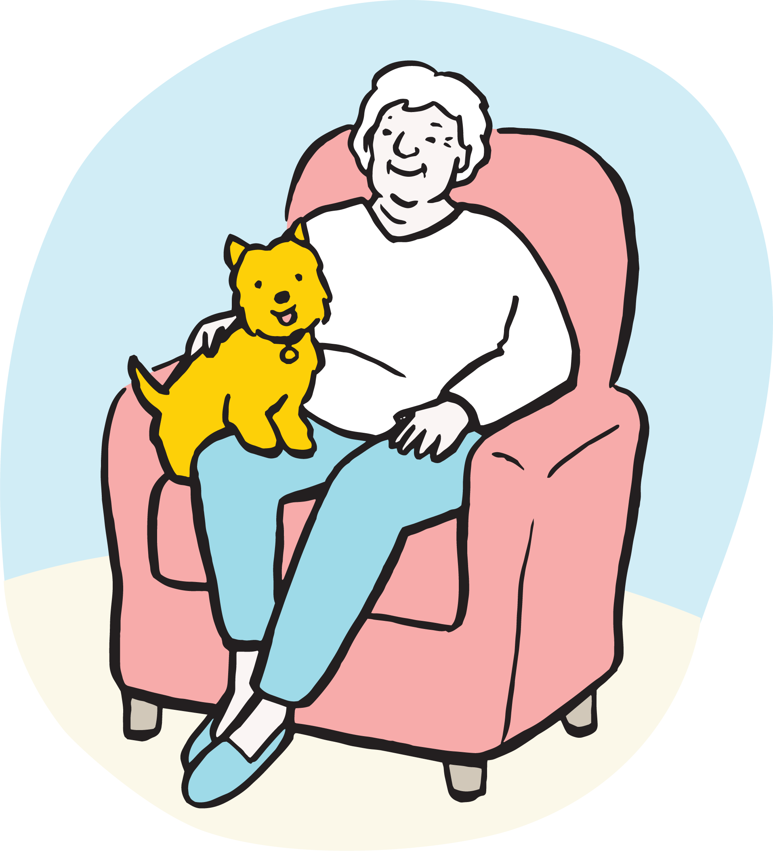
​A dog can live, ​on average, for between​ ____ and ____ years.

Slide 30
10 – 15 years
Owning a dog is a long-term commitment and how long a dog lives for can depend on their size and breed.​
Dogs are worthy of love and care throughout all of their life stages.

Slide 31
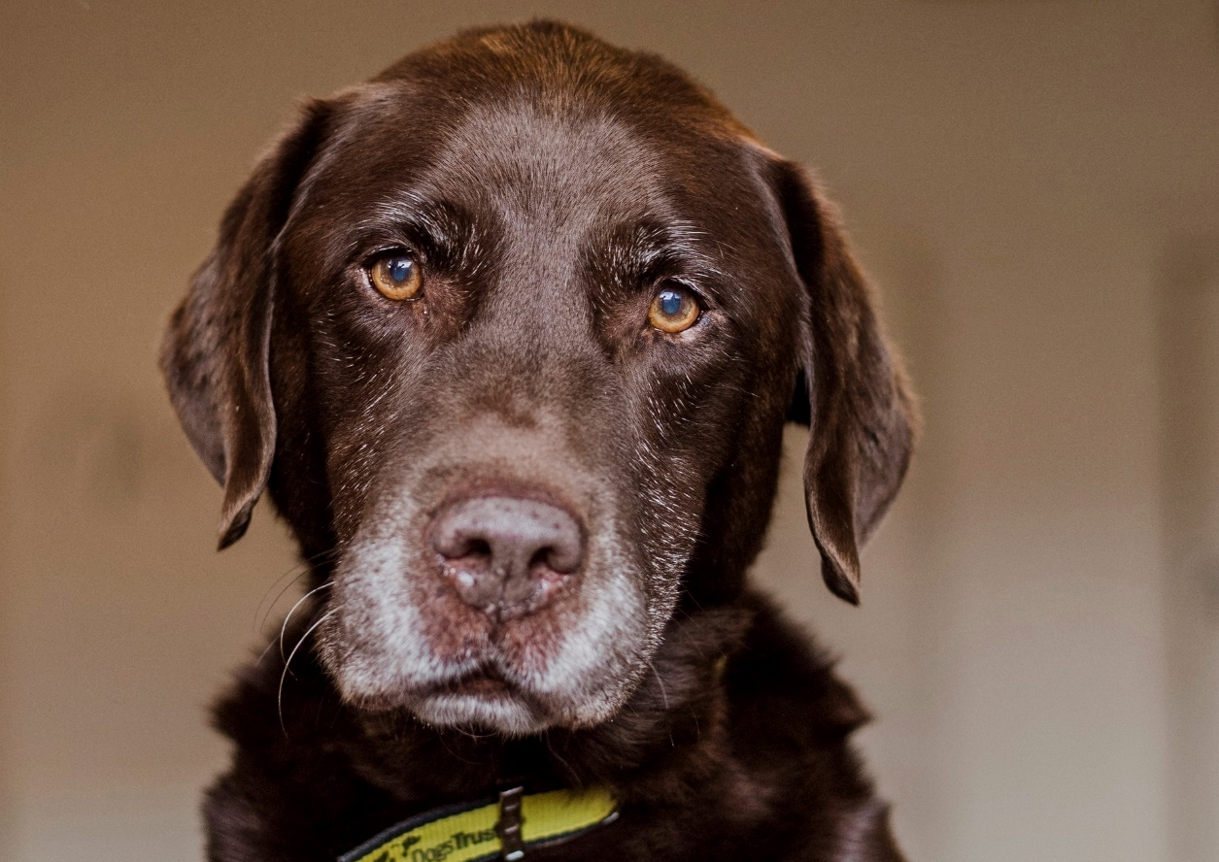

Slide 32
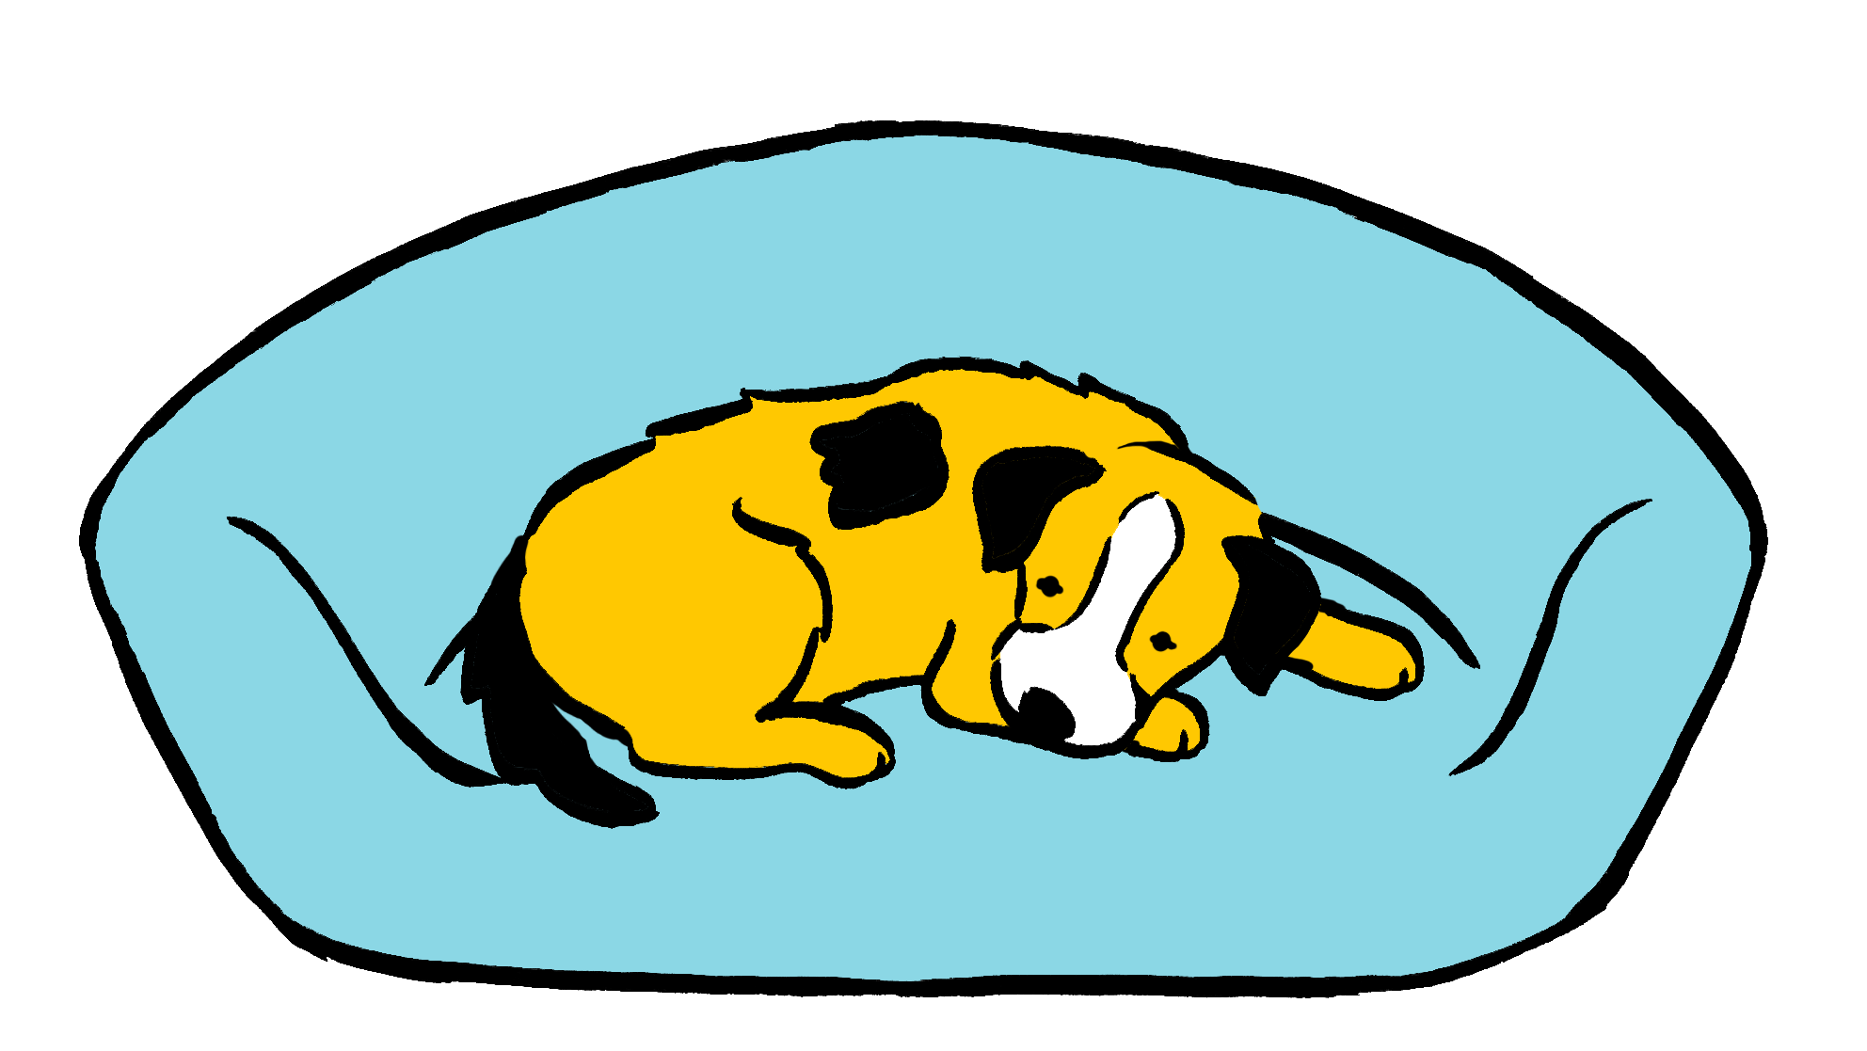
Dogs need a ​comfortable _____ to relax and sleep on.​

Slide 33
Bed
Dogs need their own space to relax and have some alone time, so it’s important they are given a comfortable place to rest and sleep that is a ‘dog-only zone’.​
Always remember that dogs need space and should be left alone when they are sleeping or resting.

Slide 34
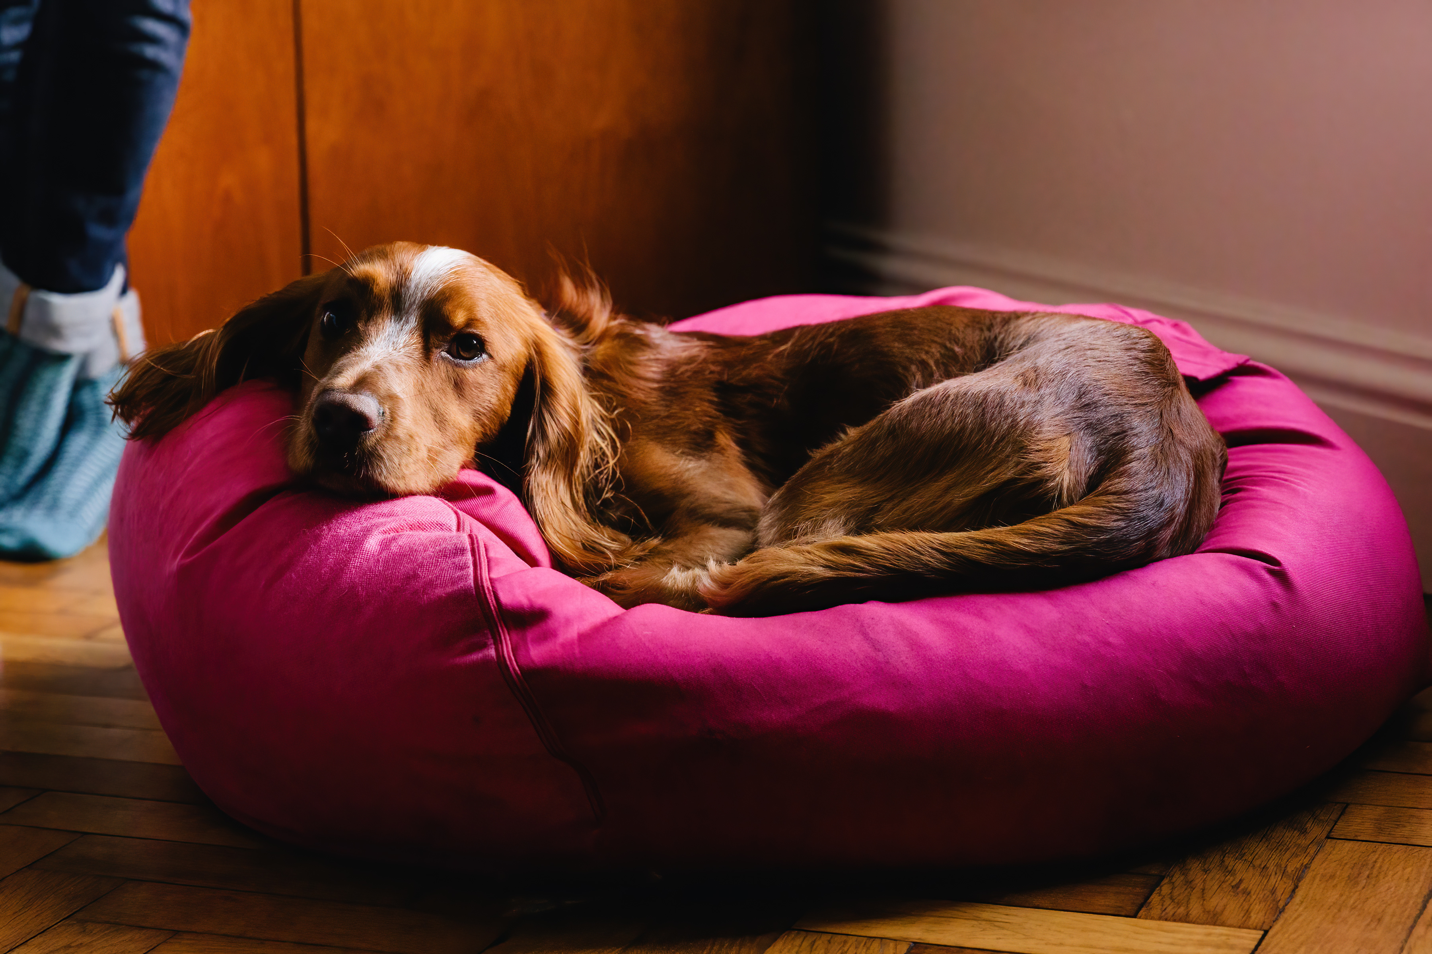

Slide 35
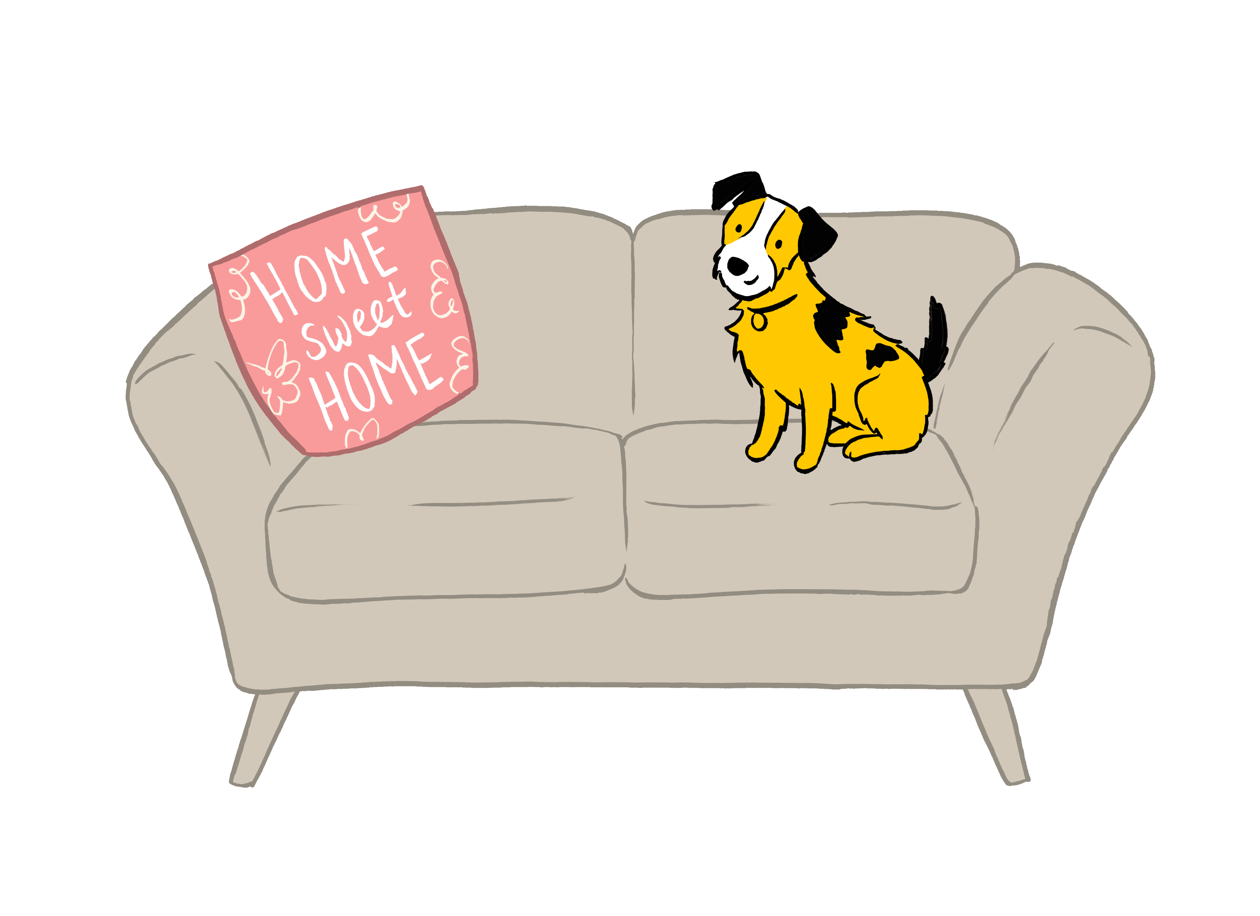
​The maximum ​number of hours Dogs Trust believes a dog should be left alone.

Slide 36
Four hours
Dogs enjoy company. They can become worried or anxious if left alone for too long. They can also become bored, which may lead to other problems such as chewing furniture!​ Chewing, however, can also be a sign of worry or stress.

Slide 37
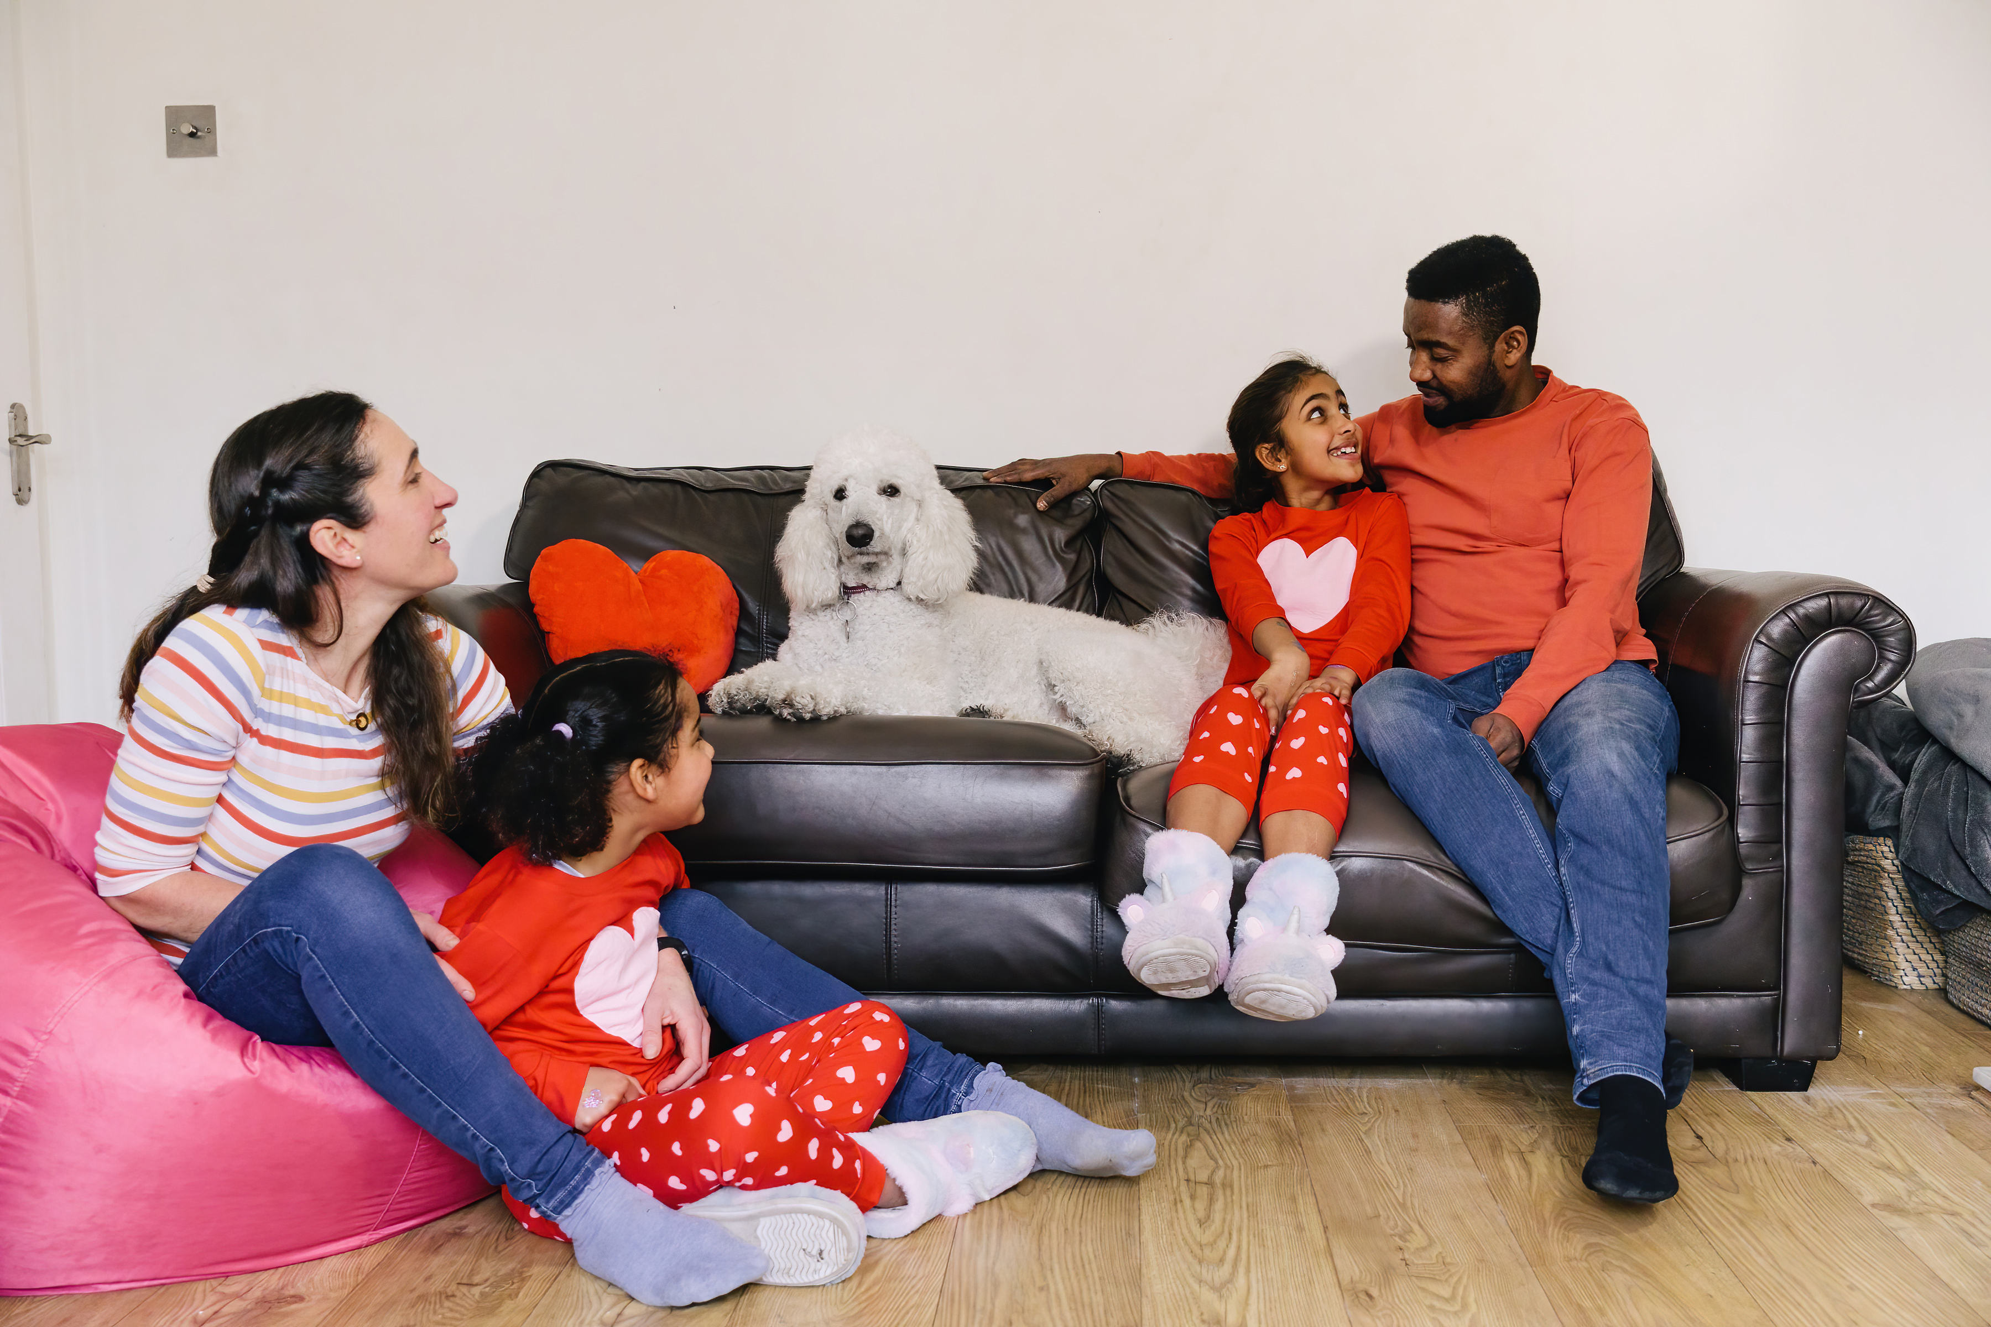

Slide 38
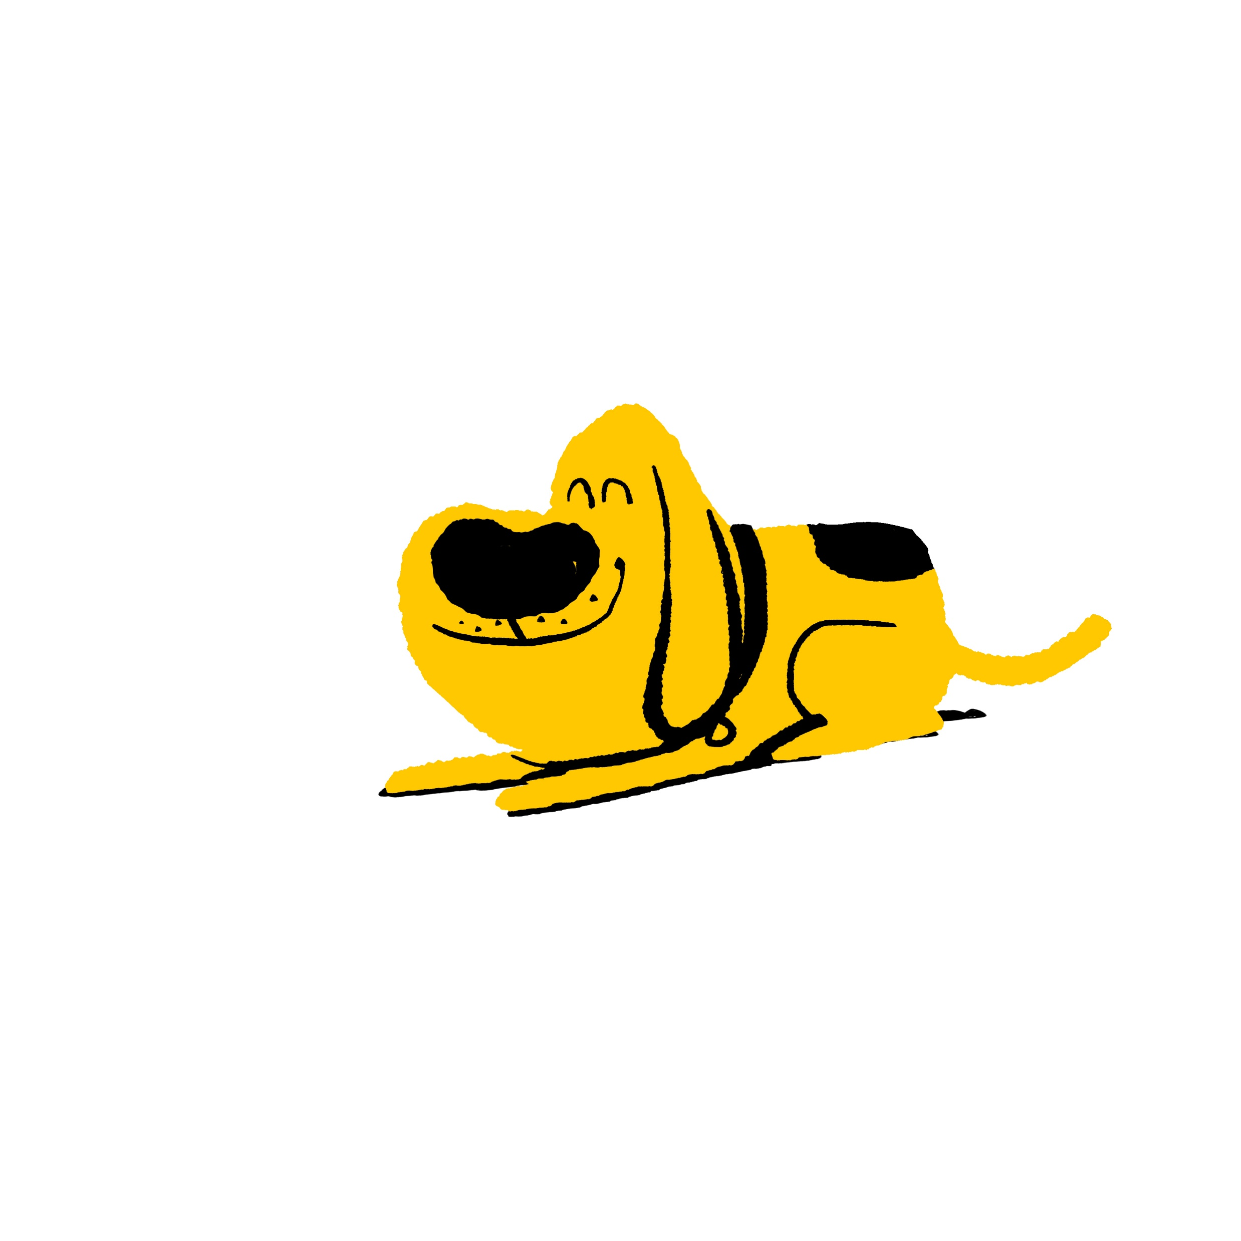
Well Done!
How many did you get right?

